Slide 1
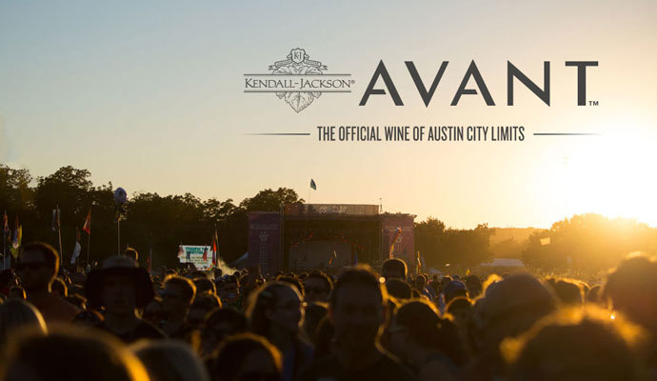
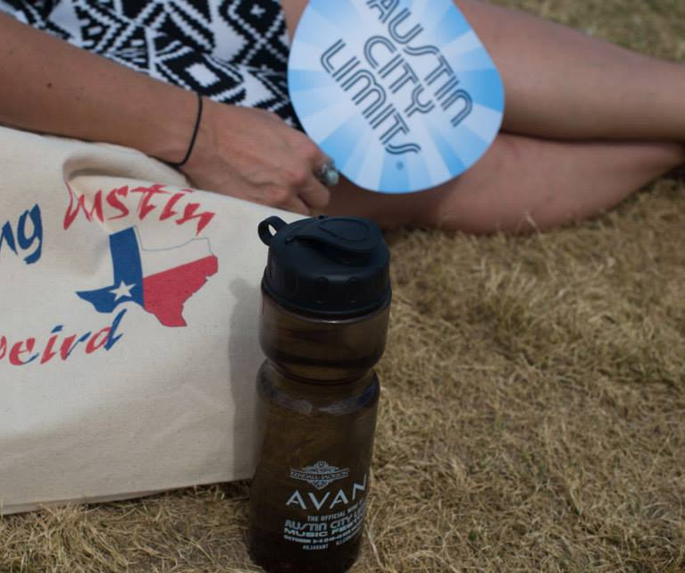
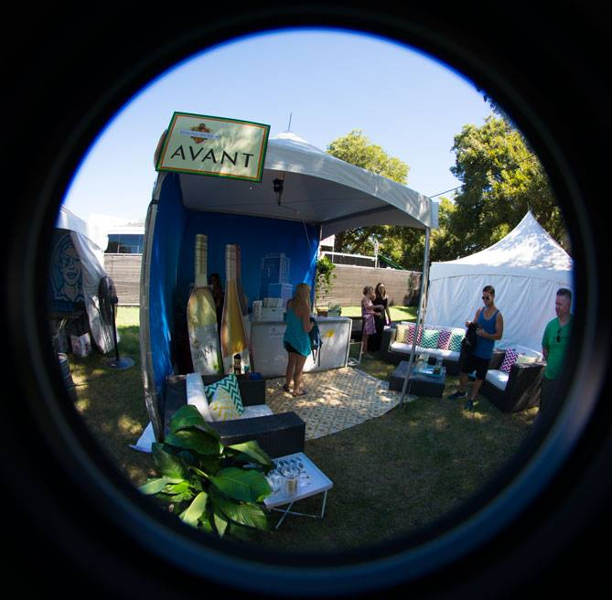
Trial – K-J. The Official Wine of ACL
Audience:
Two-weekends in October
Engaging with over 500,000 consumers
Activation:
Pearl Jam, Beck, Eminem, Lorde and more!
Wines featured at concession, VIP, media and artist tent
AVANT Sauvignon Blanc and Red Blend
Experiential marketing events
Fully integrated with R29 and Tasting Table media

Slide 2
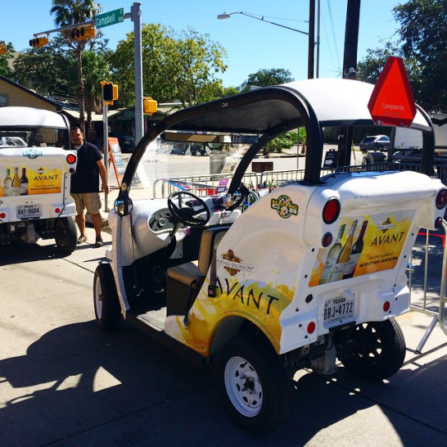
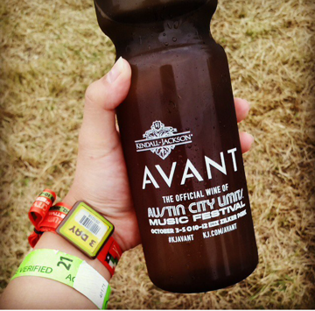
ACL Sales
TX and IL sales teams went big for K-J as well, showcasing incremental case sales / accounts sold, holding local market activations, etc.
2,900 Cases Sold
42 Austin Accounts with Displays
44 Austin Accounts Featured Jackson Family Wines
6 AVANT-branded electric Taxis (six weeks throughout Austin)

Slide 3
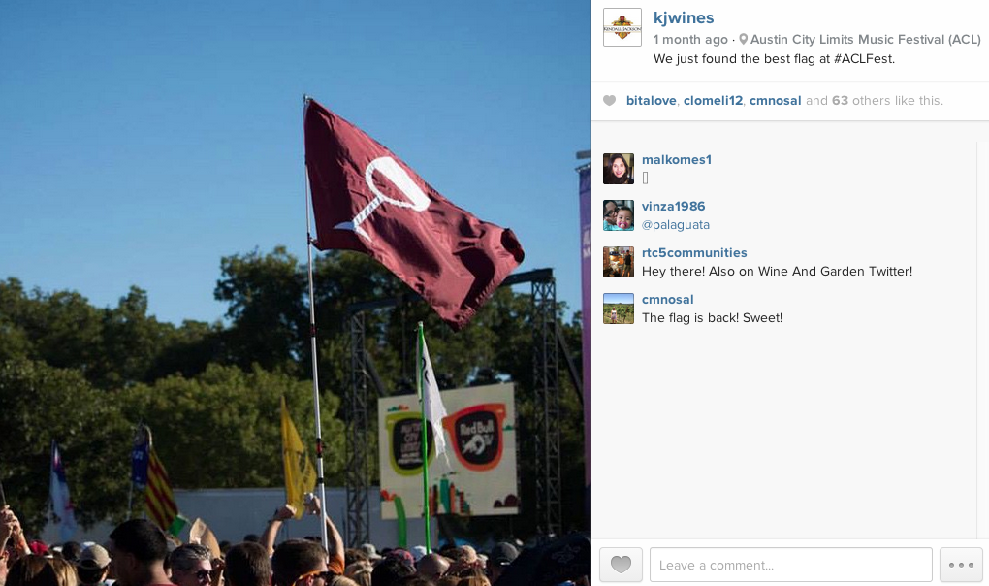
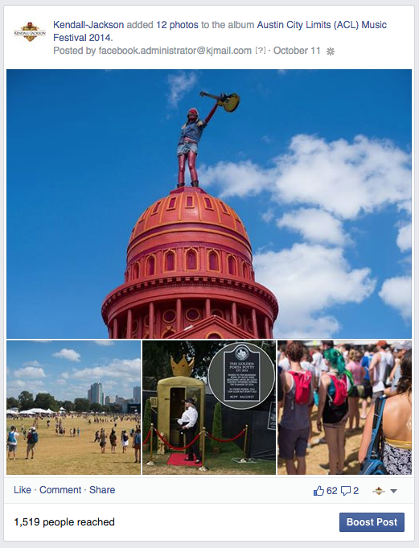
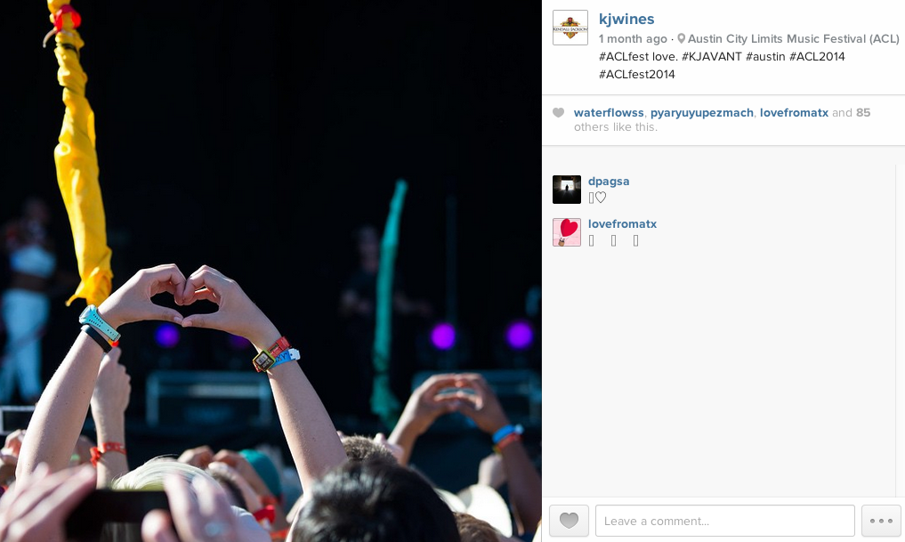
#KJAVANT #ACLFEST
Facebook
Posts: 9
Reach: 57,051
Engaged users: 4,057
Instagram
Posts: 15
Likes: 874
Comments: 47
Twitter
Tweets: 23
Reach: 63,592
Engagements: 543

Slide 4
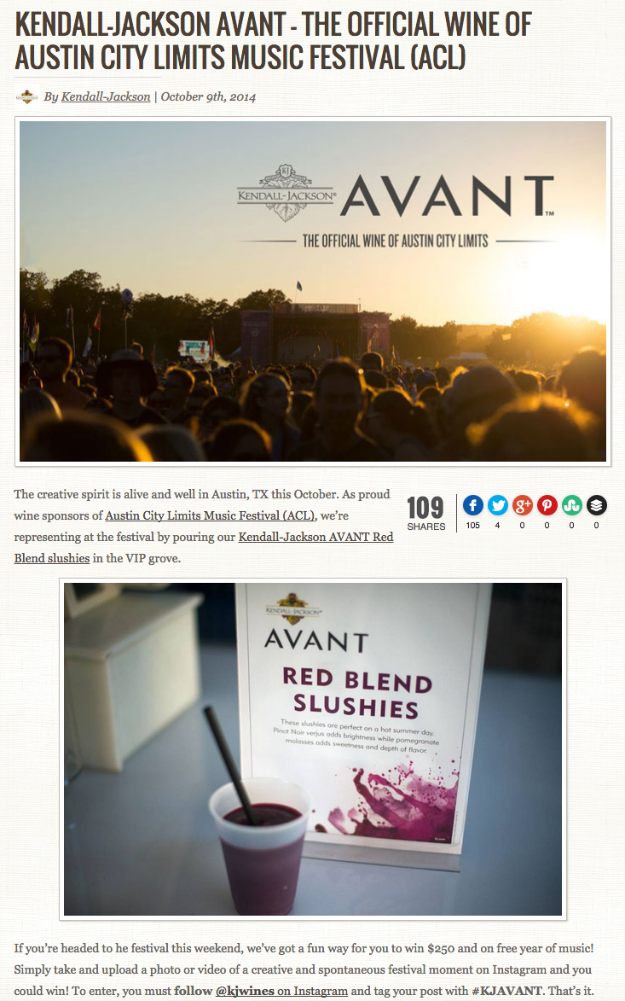
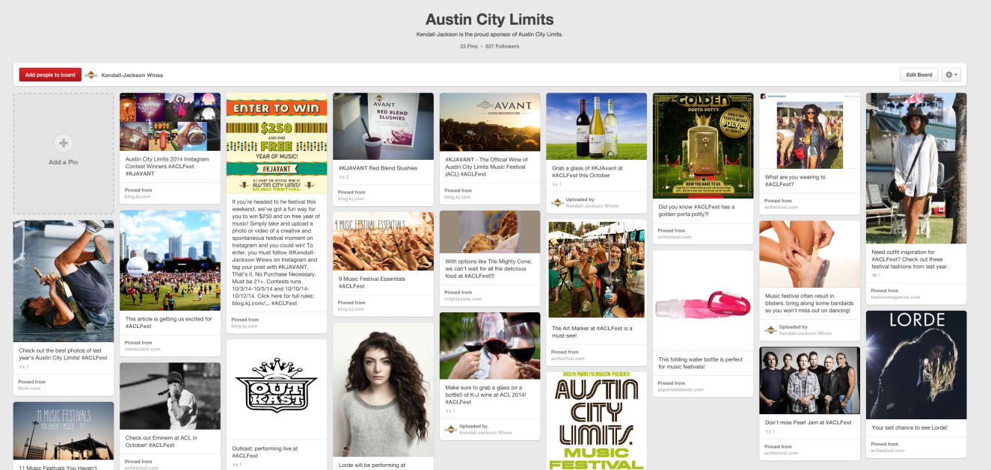
#KJAVANT #ACLFEST
Pinterest
Blog
Pins: 23
Reach: 491
Engagements: 543
Posts: 5
Page Views: 2,775

Slide 5
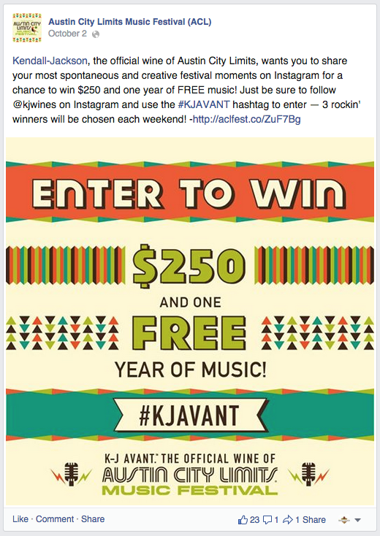
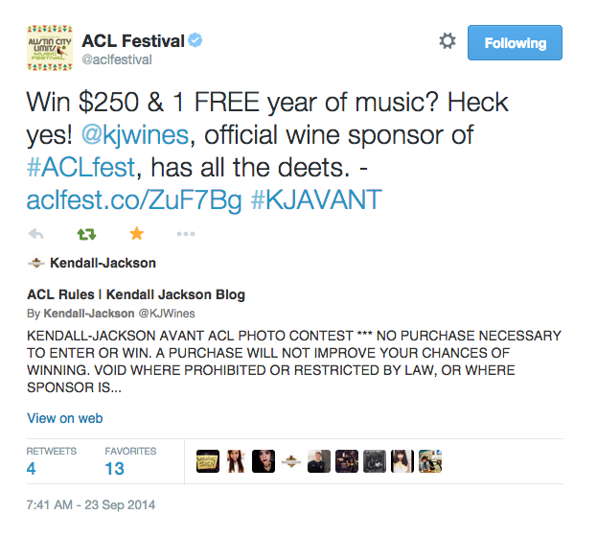
ACL’s Facebook - 404k fans
Posts: 2
Engagements 61
ACL’s Instagram – 41.6k followers
Posts: 2
Likes: 656
Comments: 16
ACL’s Twitter – 114k followers
Tweets: 3
Engagements: 46

Slide 6
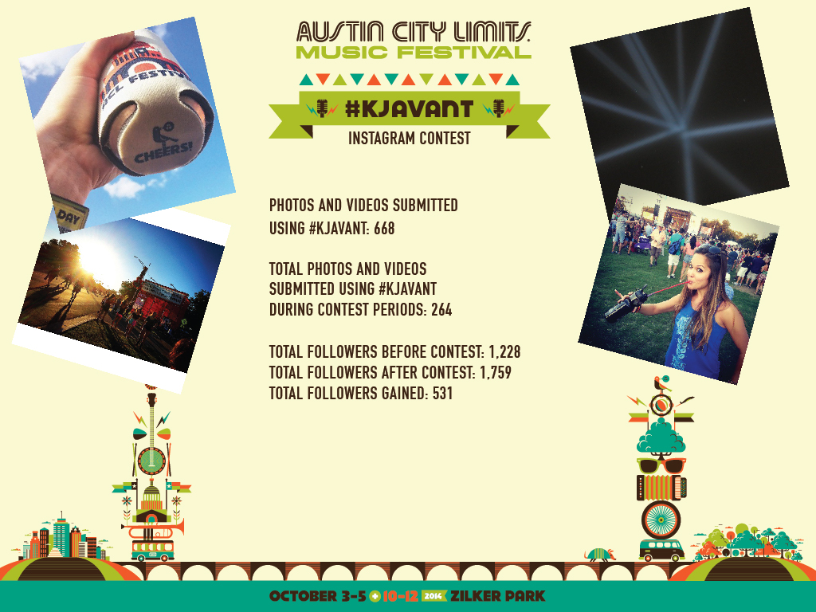

Slide 7
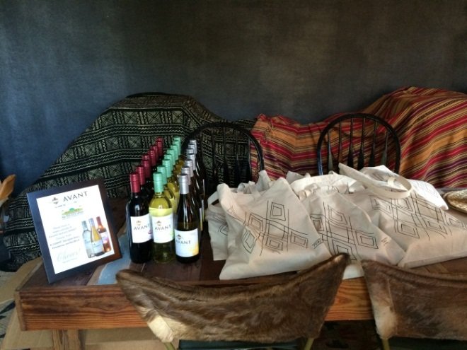
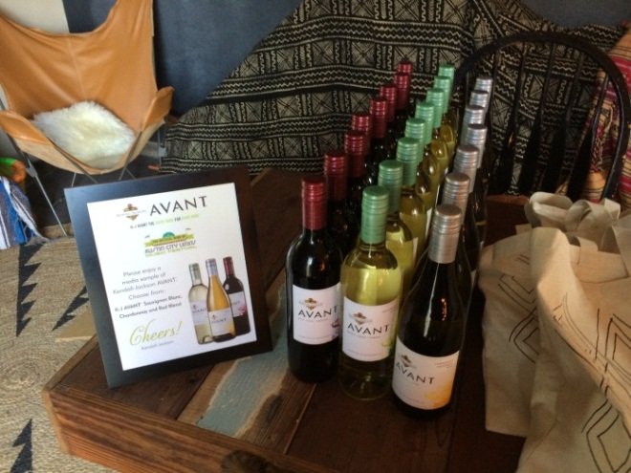
ACL Public Relations
Leverage VIP/GA tickets to build relationships with lifestyle bloggers
Reached out to several lifestyle bloggers
A few bloggers expressed interest in continuing the relationship; follow-up opportunity for spring/summer blogger activation for AVANT rooftop dinner series
Blogs included: SF Girl by the Bay, EveryGirl, SassyKitchen, Sunday Suppers
AVANT served as official wine sponsor for ACL media kickoff happy hour
Provided samples of all three AVANT wines in media gift bags as well as a postcard with contact information/info on the wines and AVANT swag; signage and ACL/AVANT coasters were prominently displayed at the event (250 – 350 press attended); will monitor for any coverage from media samples
Met with Marco from Houston, the multi-cultural sweeps influencer, who also freelances for various media outlets in Texas
Notes:
Objective/Strategy:
Leverage AVANT Sponsorship to build relationships with new media including lifestyle and music bloggers

