Slide 1
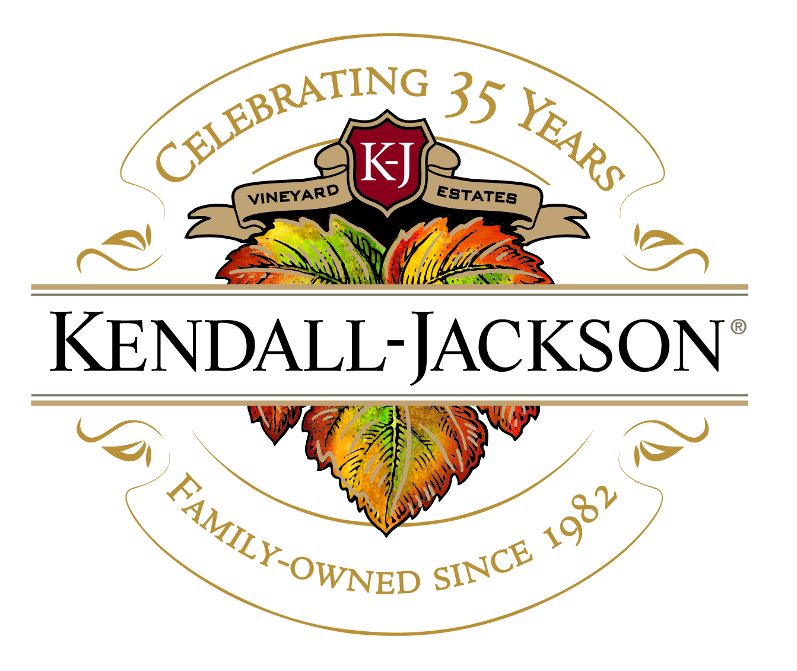

Slide 2
Outline
Wine Industry 101
Intro to Kendall-Jackson
Sustainability in the Wine Industry
How is Kendall-Jackson leading the charge?
Case Competition Launch
Interactive Activity: How do we market K-J as a sustainable winery?

Slide 3
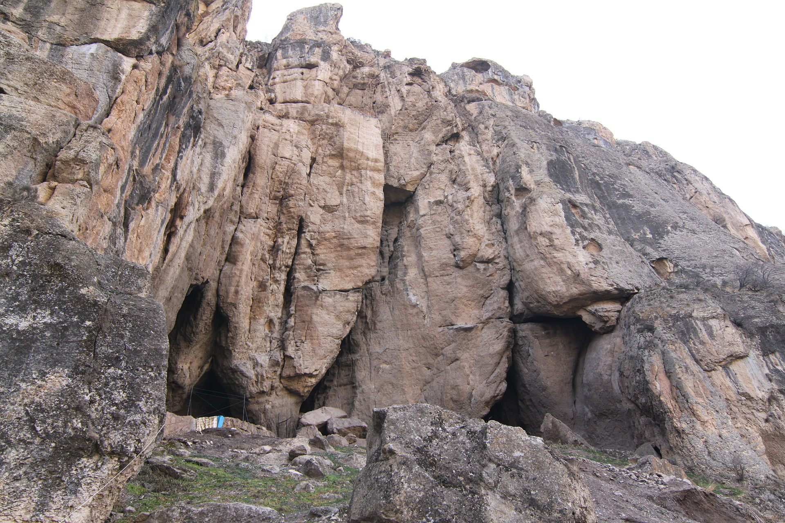
Fun Facts About Wine
Anybody know what this is?
Notes:
The oldest known winery was discovered in a cave in Armenia – dating to 4100 BC – but there is evidence that wine was produced as early as 7000 BC in China

Slide 4
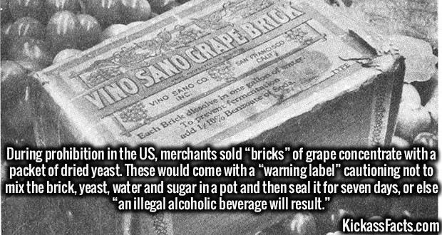
Fun Facts About Wine
Notes:
In the grand scheme of things, wine is relatively easy to make, which explains why so many ancient cultures drank it. It is produced by the natural process of fermentation – where yeasts convert sugar to alcohol

Slide 5
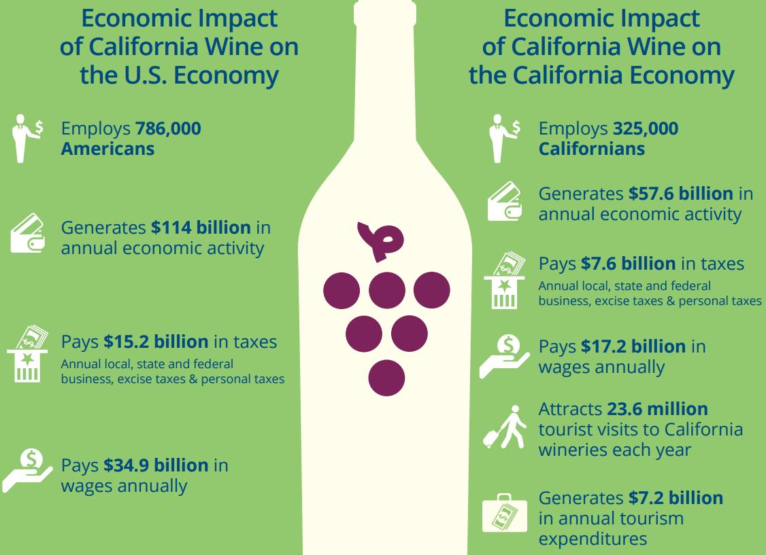
Source: California Wine Institute
Source: California Wine Institute
Notes:
4,653 wineries in CA – up from 1,450 in 2000
Producing 238 million 9L cases (all-time high) – 566.44 million gallons
That’s enough to fill 858 Olympic Sized Swimming Pools – 17 swimming pools of wine per state ☺

Slide 6
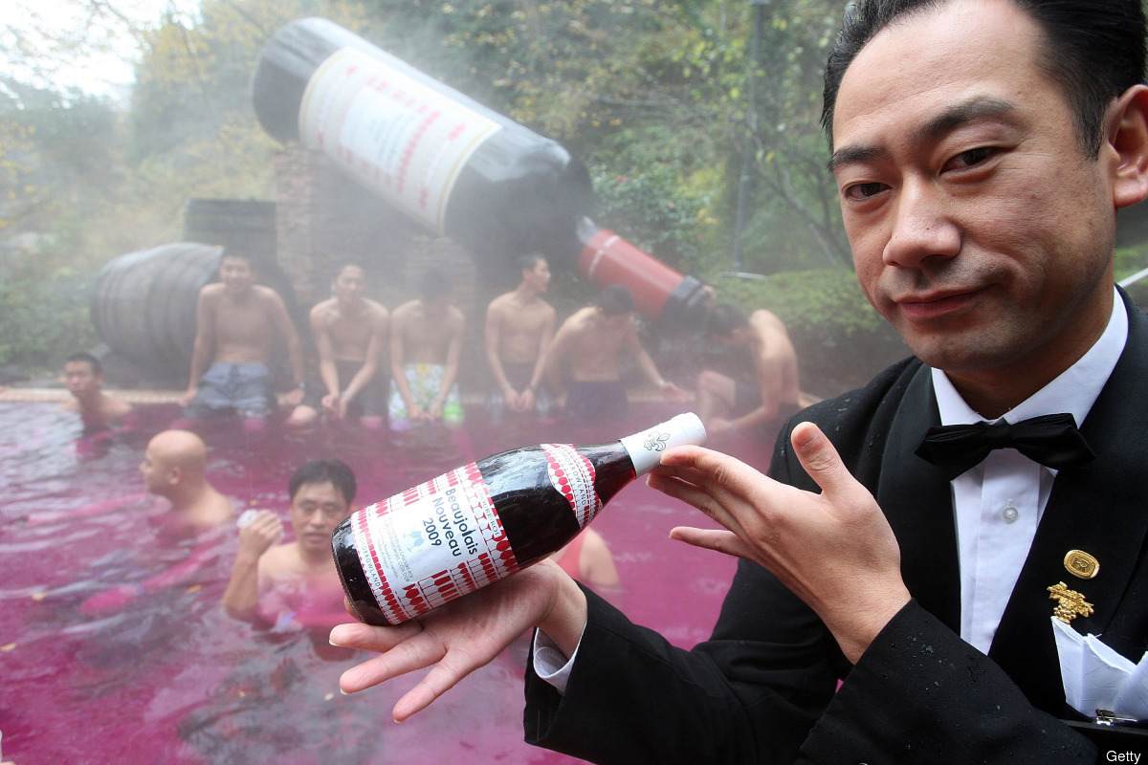
Notes:
And believe it or not, they tried just that in Japan a couple years back – but they used French wine to fill their pool because it’s not fit for drinking!

Slide 7
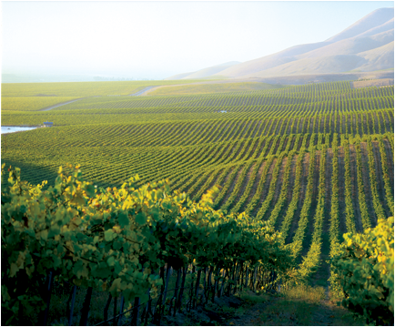
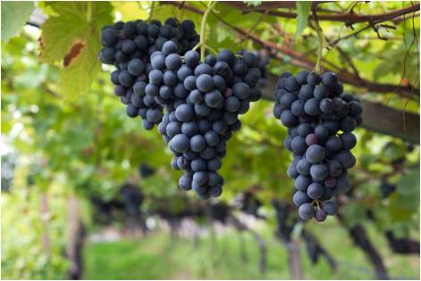
Wine Industry by the Numbers
The US has been the world’s largest wine market since 2010
CA wines selling for $10 and above account for 19% of volume and 40% of value
The domestic wine market is growing in size and complexity – 50% growth in gov’t wine label approvals from 2004 to 2016
(from 69,000 to 103,000)
There are an estimated 602,000 acres planted to winegrapes in CA, which is about ½ of 1% of the state’s total land area
Chardonnay = 20%
Cabernet Sauvignon = 15%
Pinot Noir = 6%
Sauvignon Blanc = 5%
Notes:
Move to more On Premise “in store” wine service such as coffee shops, movie theatres, bookstores, salons, etc.

Slide 8
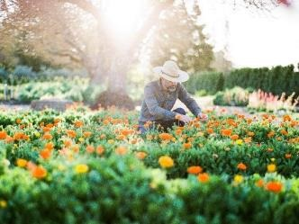
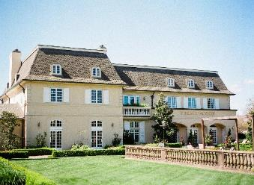
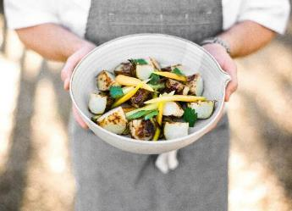
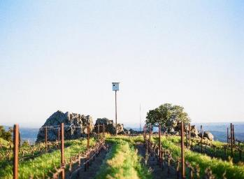
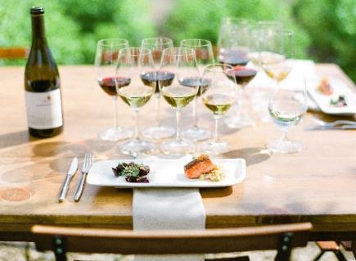
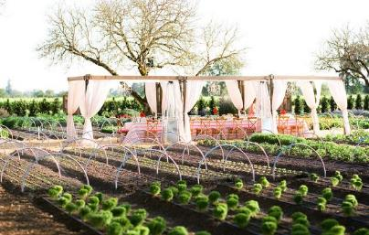
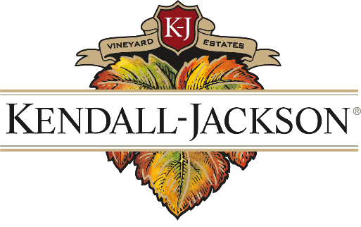
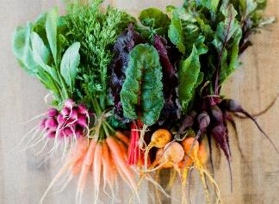
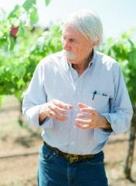
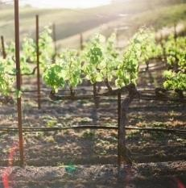
Family Owned Since 1982
Notes:
So how does Kendall-Jackson fit into this story? Kendall-Jackson – or K-J, for short – has become the ubiquitous name in California winemaking, and particularly Chardonnay. And for good reason. We’ve been family-owned ever since our foundation in 1982, and continue to embody the same family values that put us on the map to begin with.
Photos, clockwise from upper left: Master Culinary Gardener Tucker Taylor, tending to his garden at the Kendall-Jackson Winery Estate; Kendall-Jackson Winery Estate; farm-to-table cuisine from the Kendall-Jackson Estate kitchen; high-elevation family vineyard in Sonoma County; culinary garden set up for a farm-to-table dinner; the Jackson Family; vineyard; Kendall-Jackson Wine Master Randy Ullom; beautiful produce from Tucker’s garden; an educational food and wine pairing at the estate.

Slide 9
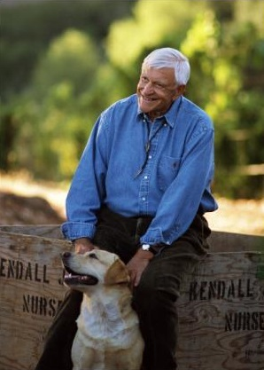
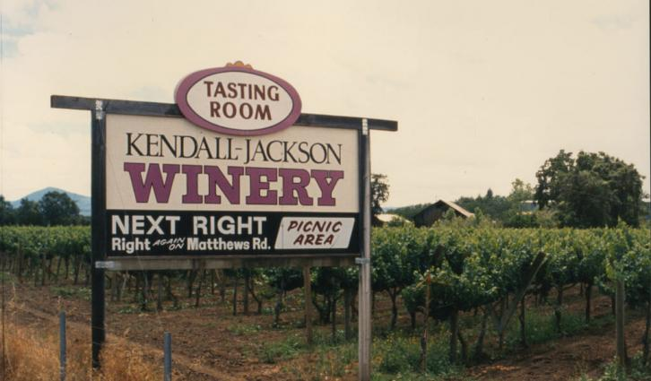
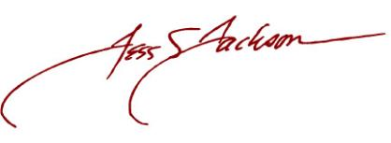
“Taking risks takes courage.”
1982 – Founded by Jess Jackson
Notes:
Kendall-Jackson was founded by the late Jess Jackson in 1982. Jess was an impressive visionary in many ways, and it shows.
Second career – K-J was his second career following a successful career in law. In the 1970s, he buys a pear orchard in Lake County, CA, plants it to grapes, and by 1982, had set out to make his own wine
Affordable luxury – With his wine, he sought to create a premium, yet affordable California wine. This was something pretty new for the US, which, since prohibition, had been producing mostly “table wine.”
Grand Central Oyster Bar – Jess sold the first case ever of Kendall-Jackson Vintner’s Reserve Chardonnay at the Grand Central Oyster Bar in NYC. That same year, the inaugural vintage of Vintner’s Reserve Chardonnay won the first-ever Platinum Award for an American Chardonnay at The American Wine Competition. Kendall-Jackson was officially on the map.
California Chardonnay – Kendall-Jackson established the classic CA Chardonnay style and sparked the growth of the premium wine industry in the US

Slide 10
#1 FOR 25 YEARS RUNNING! (IRI)
Vintner’s Reserve Chardonnay
1992
2017
Notes:
10 years after it’s conception, Kendall-Jackson Vintner’s Reserve Chardonnay became the #1 selling Chardonnay in the US, a distinction it has maintained for 25 YEARS RUNNING!

Slide 11
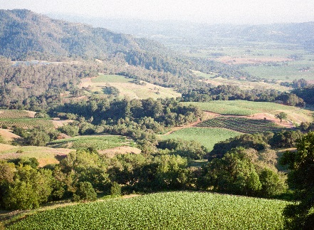
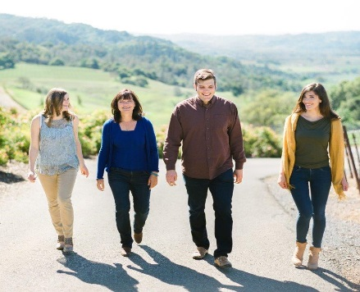
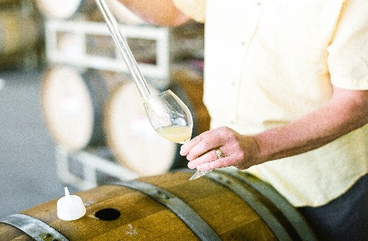
K-J Identity
Kendall-Jackson is the benchmark of excellence and integrity in family-owned California winemaking. We are trusted by multiple generations of wine enthusiasts and novices alike for crafting consistent, high-quality wines from the best marine influenced and high elevation vineyard sites, which produce grapes with rich flavors and unique character. Before winemakers, we consider ourselves Farmers First, and work tirelessly to protect the health of our land for future generations.
Land
Family
Community
Quality
Notes:
This is Kendall-Jackson’s brand statement. I’m not going to read it aloud, but want to hit on the major elements/themes that define our identity as a 35-year-old brand.
Family…integrity, excellence, and trusted…California…high-quality…speaking to the land…and keeping those future generations in mind in everything we do.
We distill these threads down into four brand pillars: Land, Family, Community, and Quality.

Slide 12
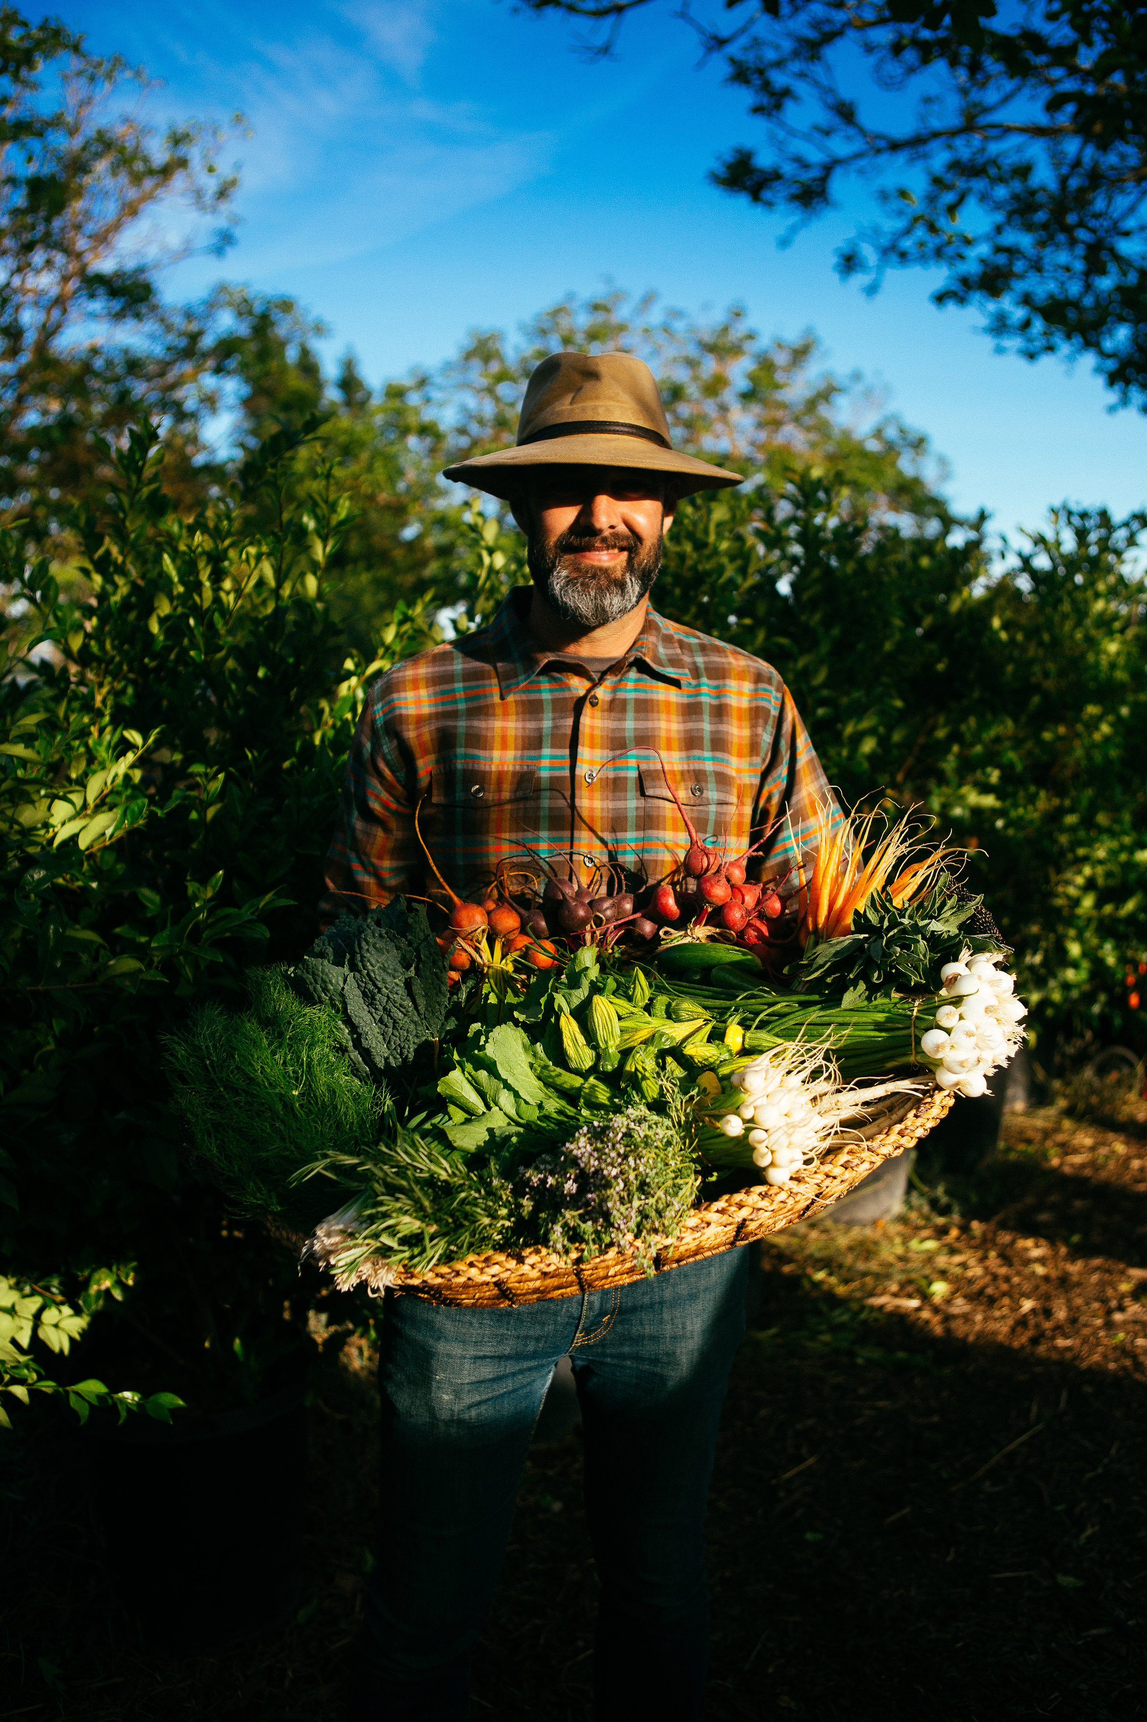
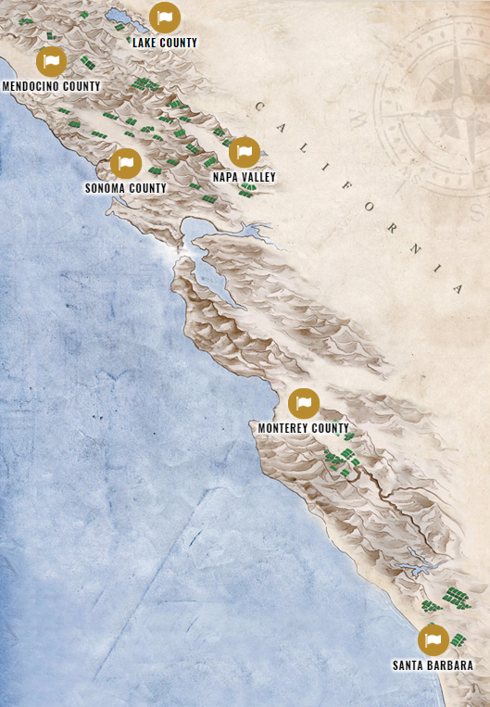
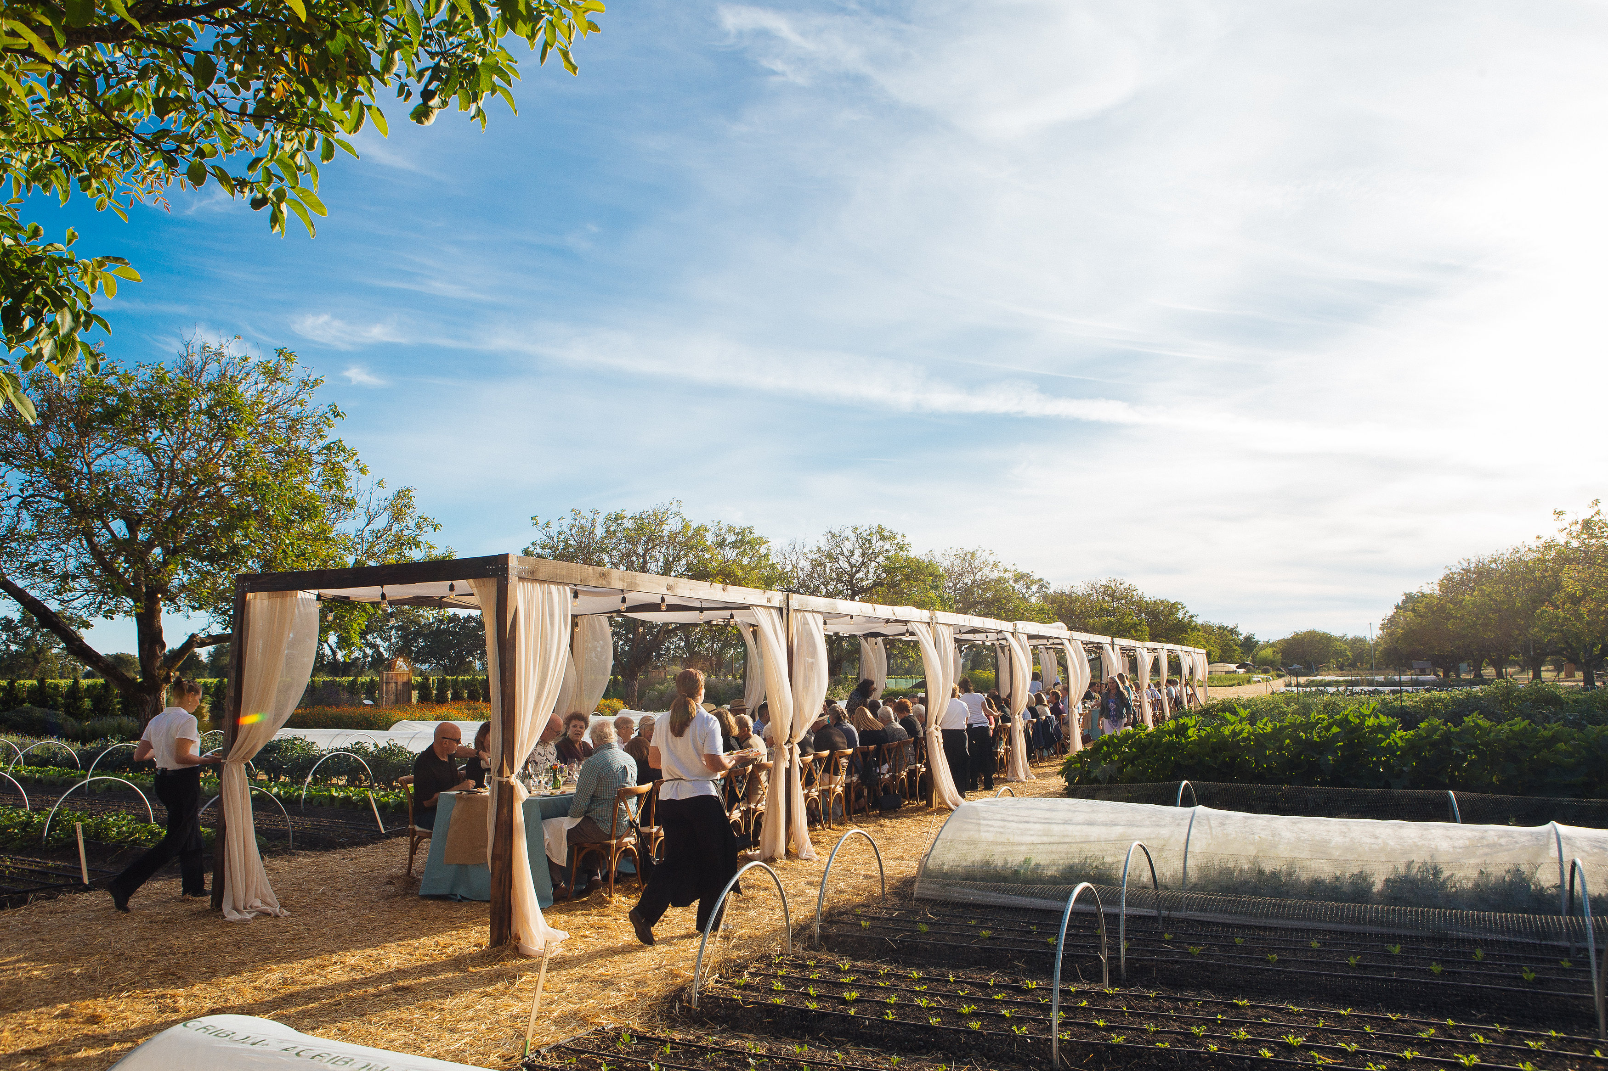
Stewards of the Land
Farmers First.
The Best Land
grows the best grapes,
making the best wines.
Kendall-Jackson estate culinary garden brings farm-to-table experience to life
Notes:
Of the four brand pillars – land, family, community, and family – I wanted to highlight LAND. Kendall-Jackson and the Jackson Family own vineyards and other properties up and down the Pacific coast; they think of themselves as stewards of their land. Not only does taking care of the land result in the best wine, but they truly believe it’s the right thing to do for our planet and future generations.

Slide 13
Core Consumers & Target
“Tom & Kathy”
Seek knowledge & curated experiences
Loyal through experience
Highly value comfort & quality of life
Planning for an active retirement
“Lauren”
Wants to be different
Seeks fulfillment
Wants to live by own rules
Motivated by quality
Willing to splurge on food & alcohol
Base: 2,794 U.S. wine drinkers
Source: ORC demographic question based on June 2016 Wine Market Council - ORC Segmentation Survey responses
Notes:
Boomers are our core, but Millennials are becoming increasingly important. Second largest generation of wine drinkers, after boomers.

Slide 14
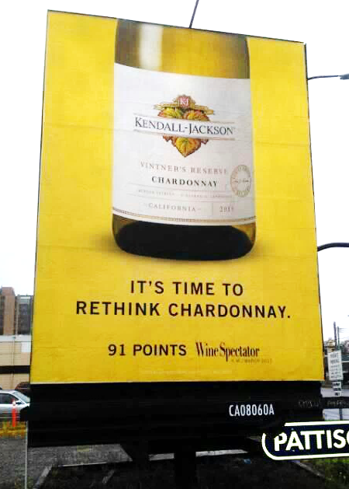
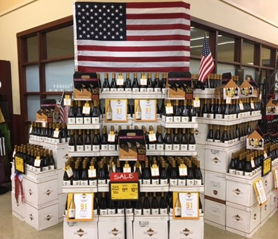
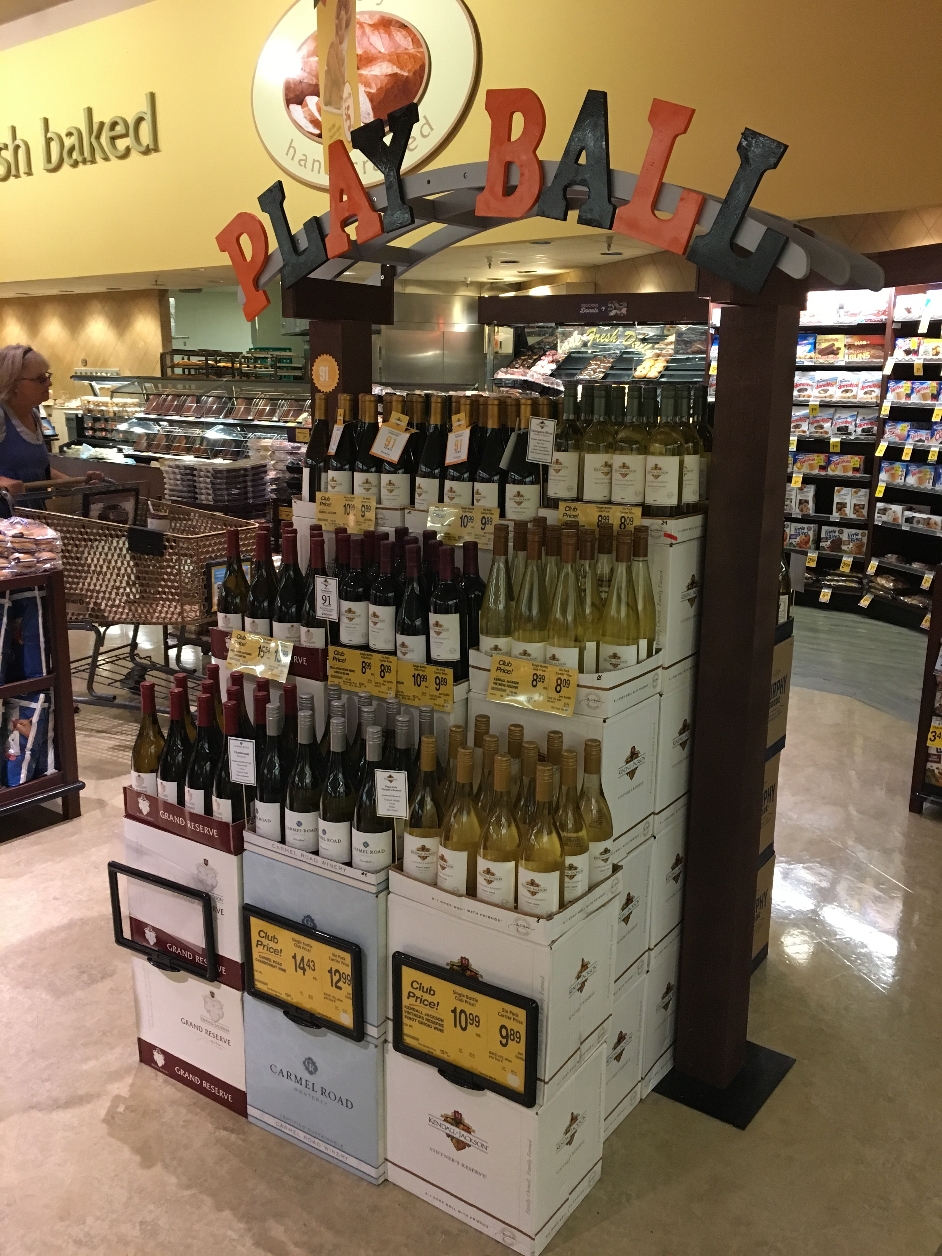
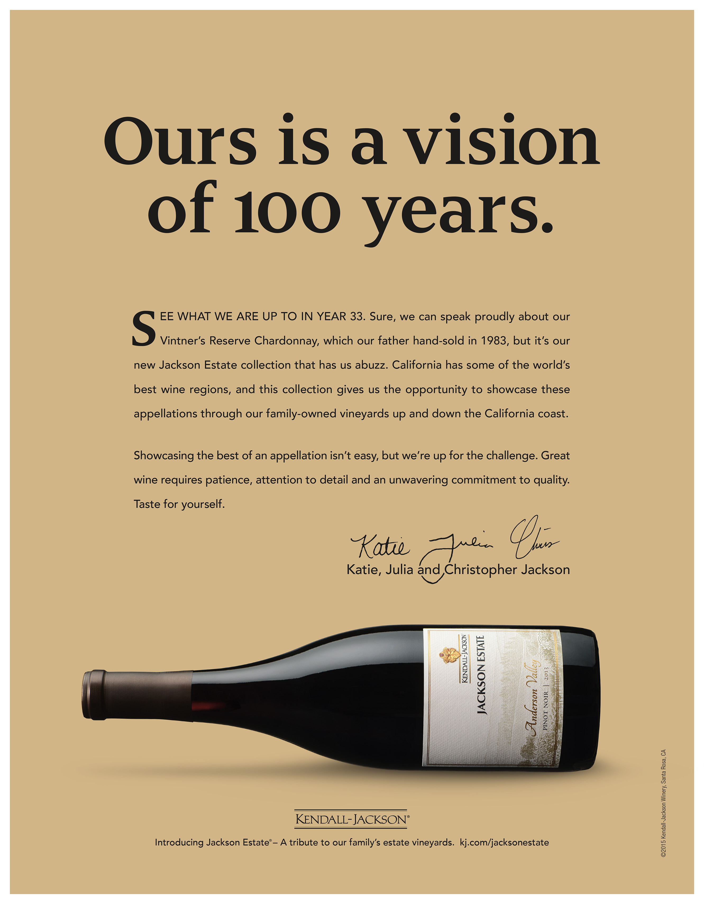
Marketing Wine
Billboards
In-store Experience
As well as…
Partnerships, Radio, On-Menu, etc...
Print Advertising
Notes:
As we continue our presentation, here are some of the major wine marketing channels to keep in mind. The great majority of our attention and spend goes to capturing consumers’ attention at the point of purchase, which for Kendall-Jackson, is mostly IN-STORE. Displays, printed point of sale materials that go around the neck of the bottle or attach to the cases, etc.
Also: print advertising in wine and lifestyle publications, billboards, etc.

Slide 15
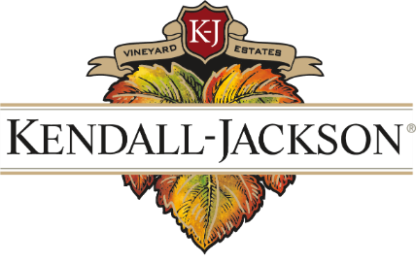
SUSTAINABILITY IN WINE

Slide 16
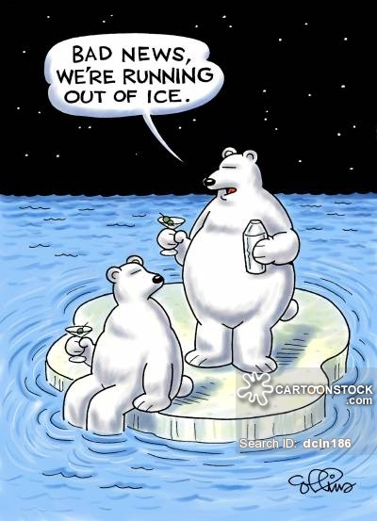

Slide 17
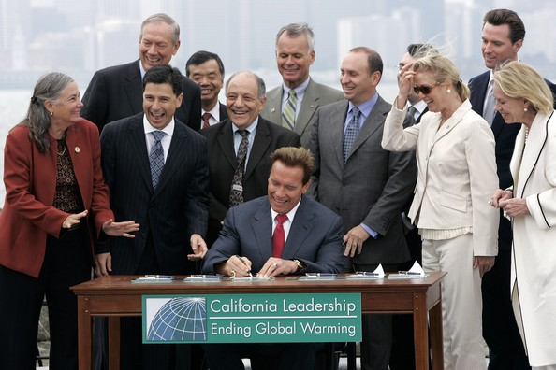
How did we get here?
Notes:
Our establishment in 2008 in response to AB32
Talk through Org Chart – how I ladder up

Slide 18
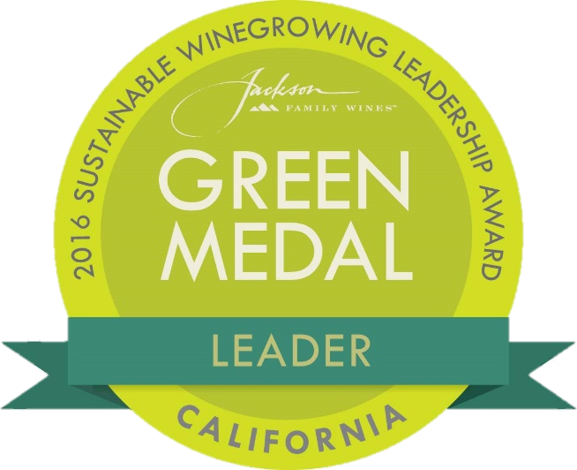
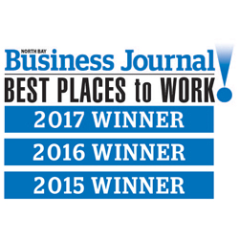
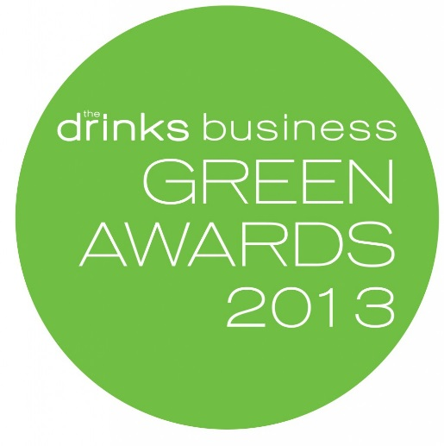
Our Sustainability Awards: Leading the Industry

Slide 19
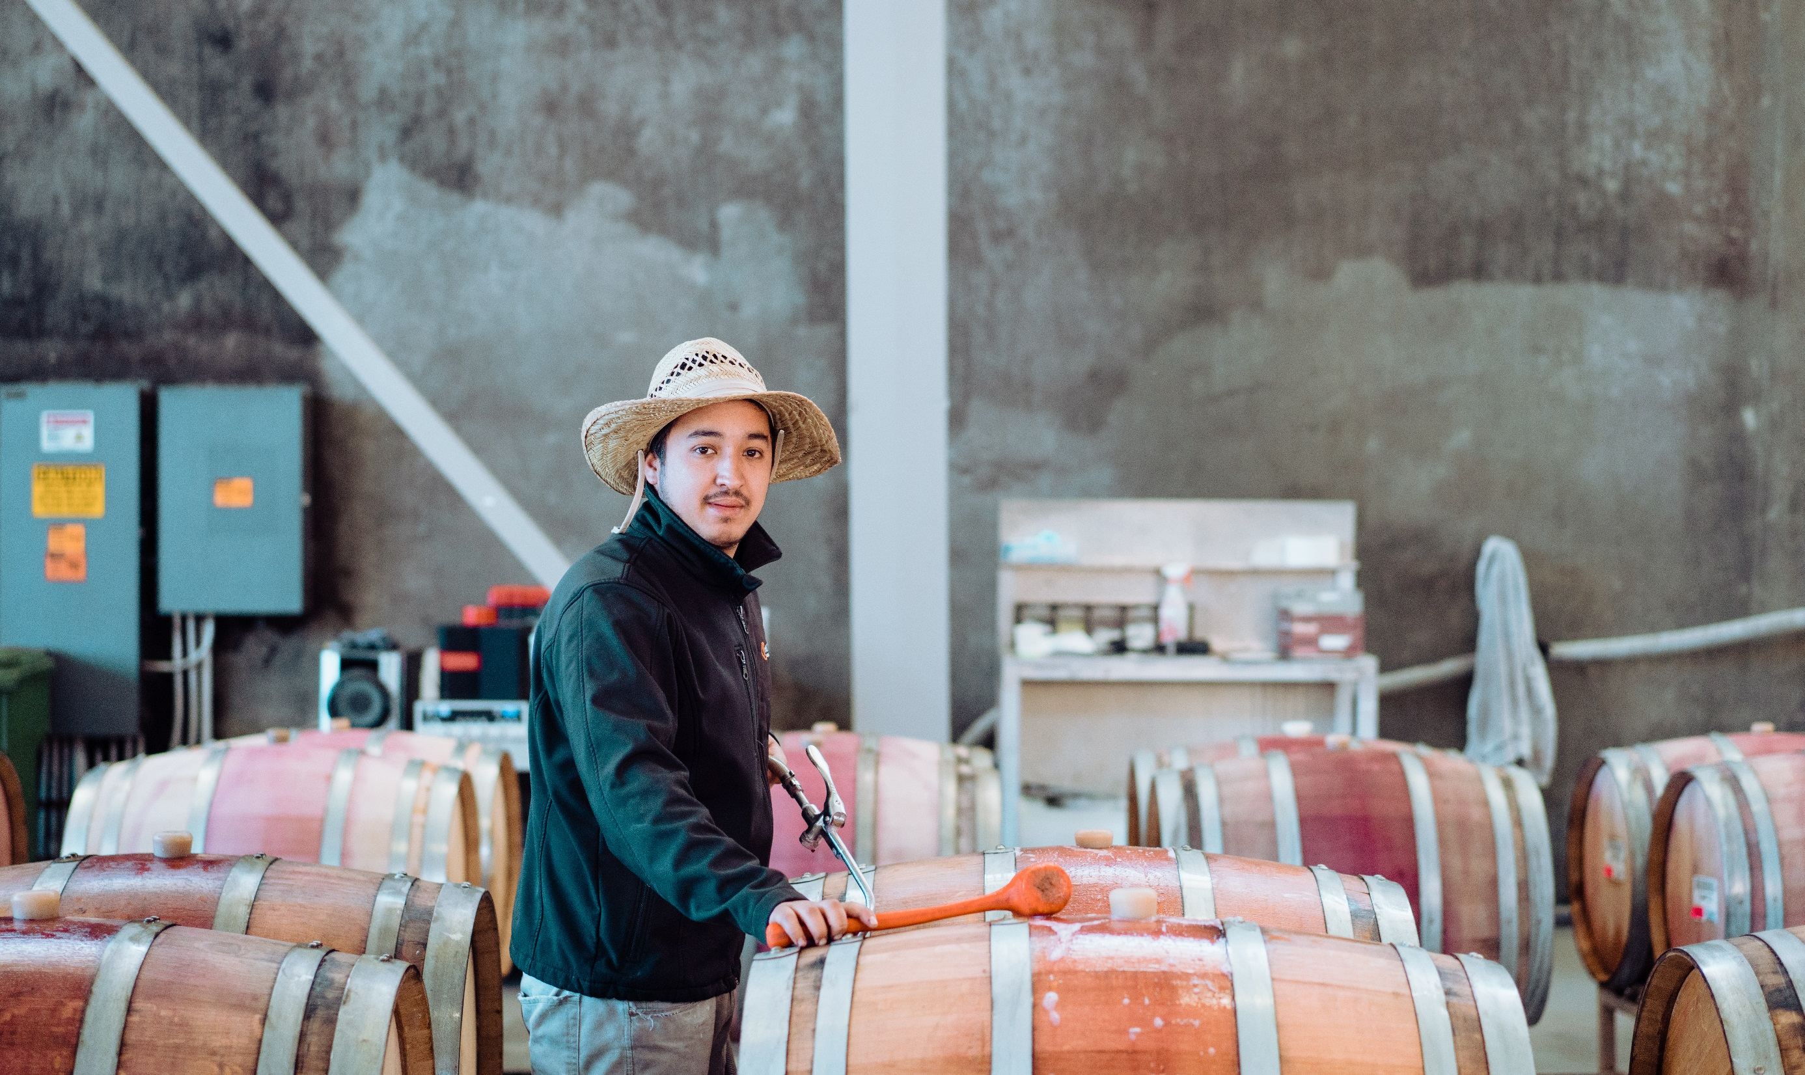
Current KJ Sustainability Messaging (Rebecca & Julien)
PEOPLE FIRST
Notes:
$15/hour minimum hourly base pay
7 year average employee tenure
$4M donated to UC Davis to build the Jess S. Jackson Sustainable Winery Building
More than 50 community-based non-profits supported each year
Rooted for Good companywide community volunteer program gives every employee 2 days off to volunteer in their community
JFW Cares Foundation provides financial assistance to employees who are facing unexpected emergencies or significant hardships

Slide 20
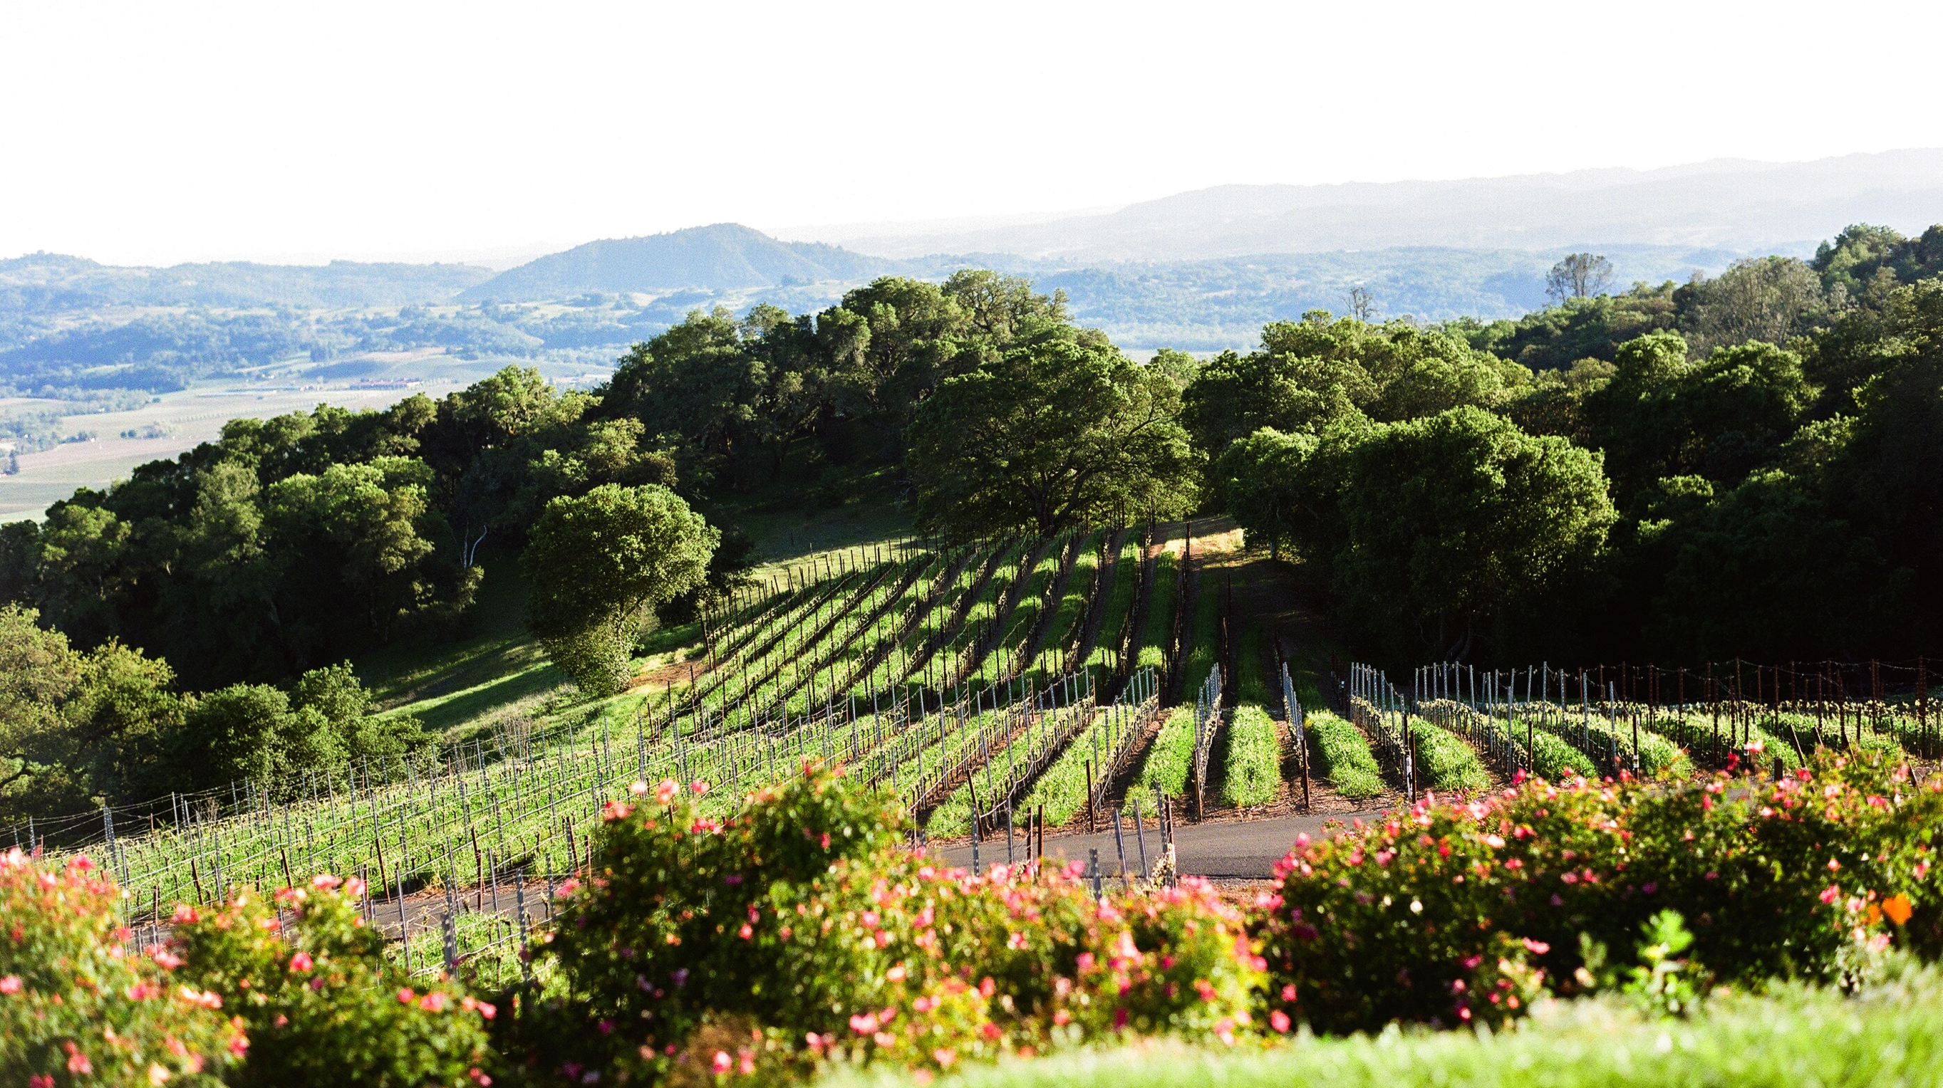
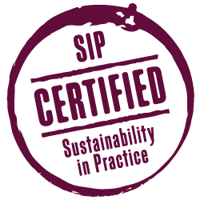
Current Wine Sustainability Certifications
LAND MATTERS
Notes:
We leave more than half of our land unplanted, protecting thousands of acres to preserve biodiversity. Native trees and riparian corridors surrounding our vines create habitats for wild species such as beneficial birds and insects that naturally control pests.
Responsible farming practices are employed in each vineyard to reduce water use, while also encouraging soil enhancement and erosion control.
15 years average tenure among our vineyard managers. Each embraces the importance of maintaining land health through restoration and biodiversity.
Agency collaborations support endangered species habitat protection & restoration. In 2015, we collaborated with the California Department of Fish & Wildlife and other agencies to release water from our vineyard reservoir to raise water levels in a key tributary to support endangered Coho salmon.

Slide 21
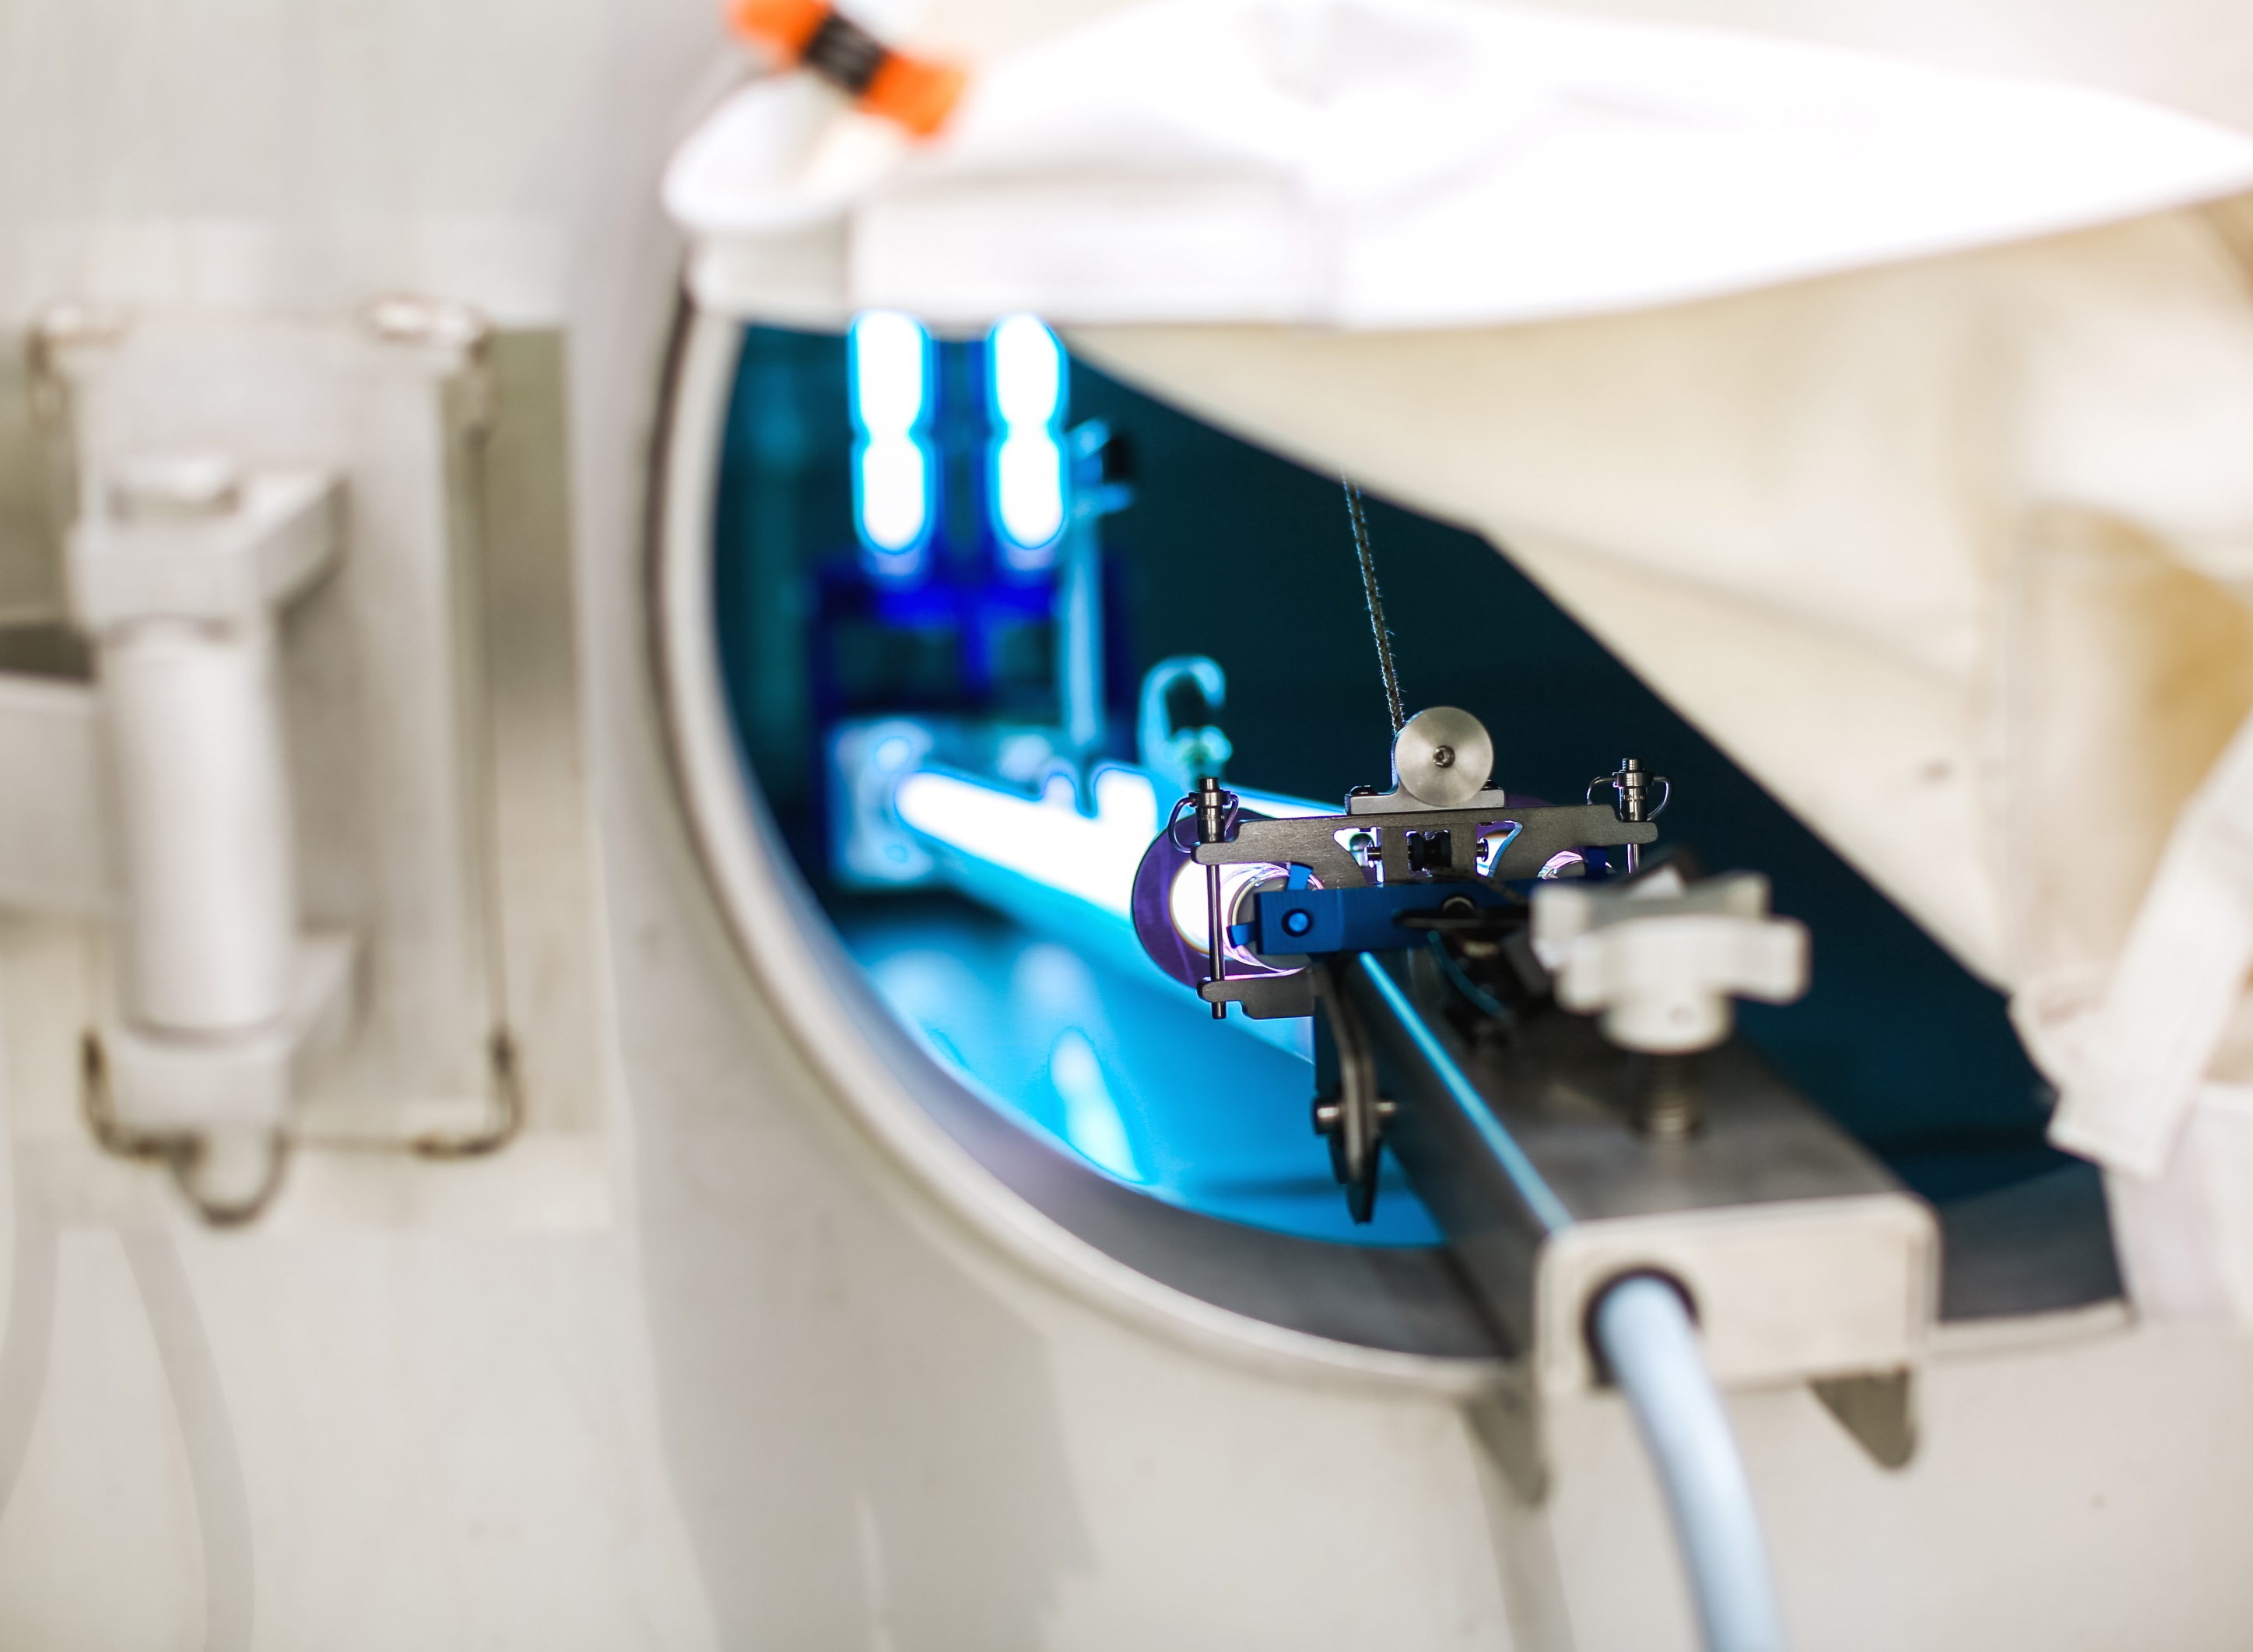
Current Wine Sustainability Certifications
SAVING EVERY DROP
Notes:
We achieved a 61% reduction in water use since 2008, equivalent to 32 million gallons saved annually. This was driven primarily by employee led Winery Water Conservation Teams and an investment in new technologies.
Today, we use 50% less water than the industry average to produce our wines.
We have pioneered the development of innovative systems such as barrel & tank wash water recycling, waterless tank sanitation and rainwater harvesting.
We irrigate our vineyards with recycled water wherever possible and converted to drip irrigation in the late 1980s. We use wind machines as well as atmospheric, vine and soil monitoring to conserve water and improve grape quality.

Slide 22
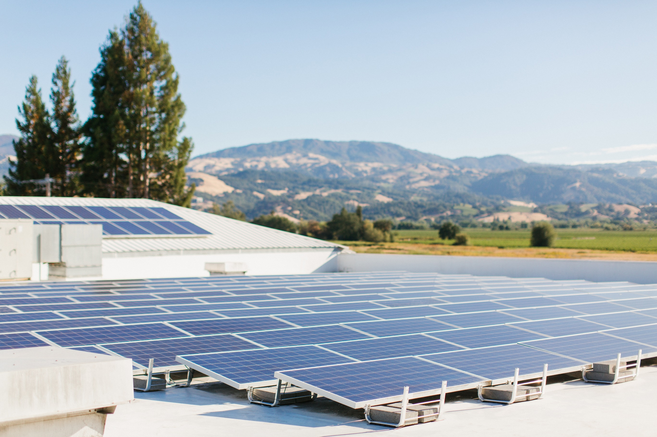
Current Wine Sustainability Certifications
POWERING THE FUTURE
Notes:
We reduced GHG intensity by 17% and electricity intensity by 13% across our wineries since 2008.
We are the US wine industry’s largest generator of onsite solar energy with 7.1MW of generation capacity across 9 wineries. By reinvesting our energy efficiency savings in clean, renewable energy, we offset over 1,500 homes’ worth of annual electricity use.
Our vision to someday take a winery entirely off grid drove our collaboration with Tesla Energy to deploy 4.2MW of onsite stationary energy storage systems. These batteries take energy from our solar arrays and store them for use at night to power our wineries.
We are one of a few companies in the US that purchases enough Renewable Energy Certificates to offset annual electricity emissions for both our companywide usage and all of our employees’ home usage.

Slide 23
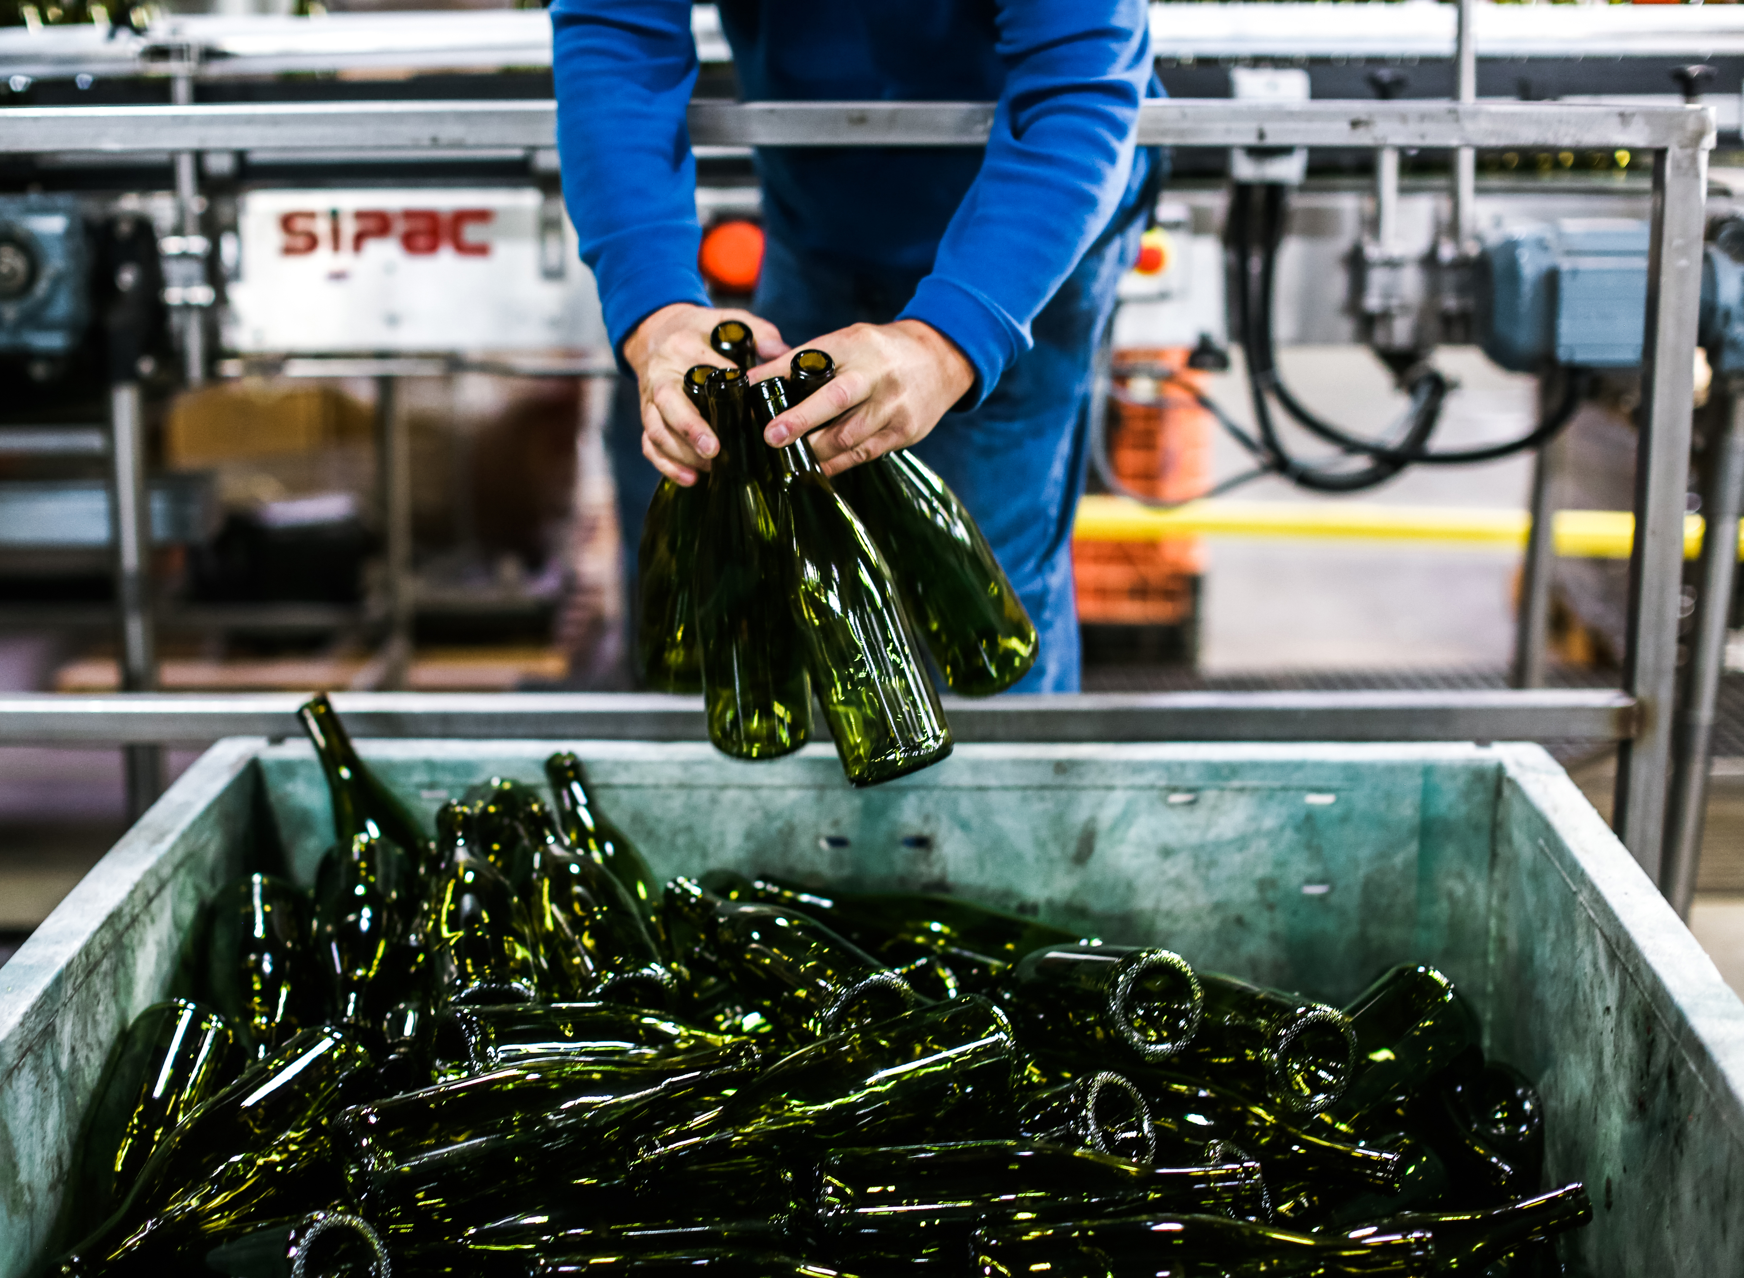
Current Wine Sustainability Certifications
WASTE DIVERSION EFFORTS
Notes:
We partnered with a local recycling center to develop a program that diverts 98% of all materials used on our bottling line annually, including glass, labels, corrugate, plastic sheeting, and e-waste. This initiative is being rolled out to all wineries, vineyards and hospitality centers companywide.
Our partnership with a stave mill in France ensures us the first pick of responsibly managed oak trees for our high quality barrels, and proprietary technology enables us to get the maximum amount of wood out of each log, reducing a critical supply chain waste stream.
WholeVine, our sister company, utilizes harvest byproducts (grape skins & seeds) to make healthy culinary products, including gluten-free flours, grapeseed oils, and nutraceutical ingredients.
Lightweight bottle

Slide 24
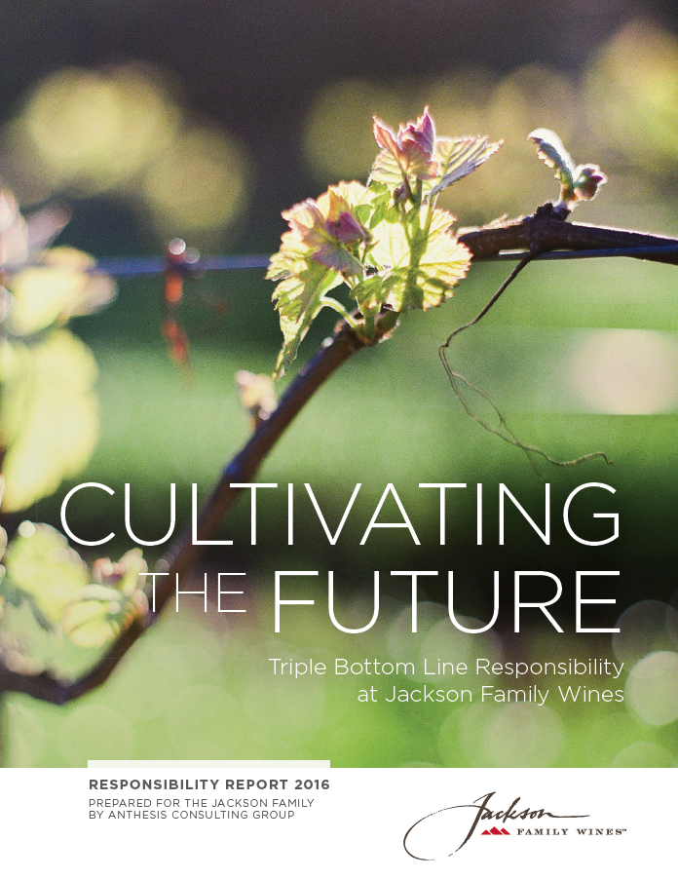
Inaugural Sustainability Report & Goals
Jackson Family Wines Unveils New Report, Goals Aimed at Advancing Field of Sustainable Wine
Our 2021 Goals:
One land conservation/restoration project per year
85% certified sustainable grower fruit
50% of winemaking energy offset from onsite renewables
33% reduction in water intensity per gallon produced
25% reduction in GHGs per gallon produced
Achieve Zero Waste tasting rooms & wineries
Establish domestic internship program
75% participation rate in volunteer program annually
Pilot or continue experimental trial each year
Notes:
Introduce Sustainability Report & Key sustainability goals

Slide 25
CONSUMERS & SUSTAINABILITY

Slide 26
Challenges & Opportunities
Notes:
So here’s what we know already.

Slide 27
Kendall-Jackson Sustainability Messaging
“We take big steps to leave small footprints.”
Water
Kendall-Jackson wines are produced with 1/3 less water than industry standard.
Solar
Kendall-Jackson wines are vinted and bottled leveraging the largest solar generator in the wine industry.
Renewable Energy
Kendall-Jackson wines are vinted and bottled with 100% certified renewable electricity.
Land
100% of our estate vineyards and wineries are certified sustainable by the CCSW Winegrowing program.
Notes:
Doing a LOT! Here’s how we’ve distilled our internal goals & objectives into K-J’s consumer messaging… This lives on our website, kj.com, and has also been translated into some of our campaigns…

Slide 28
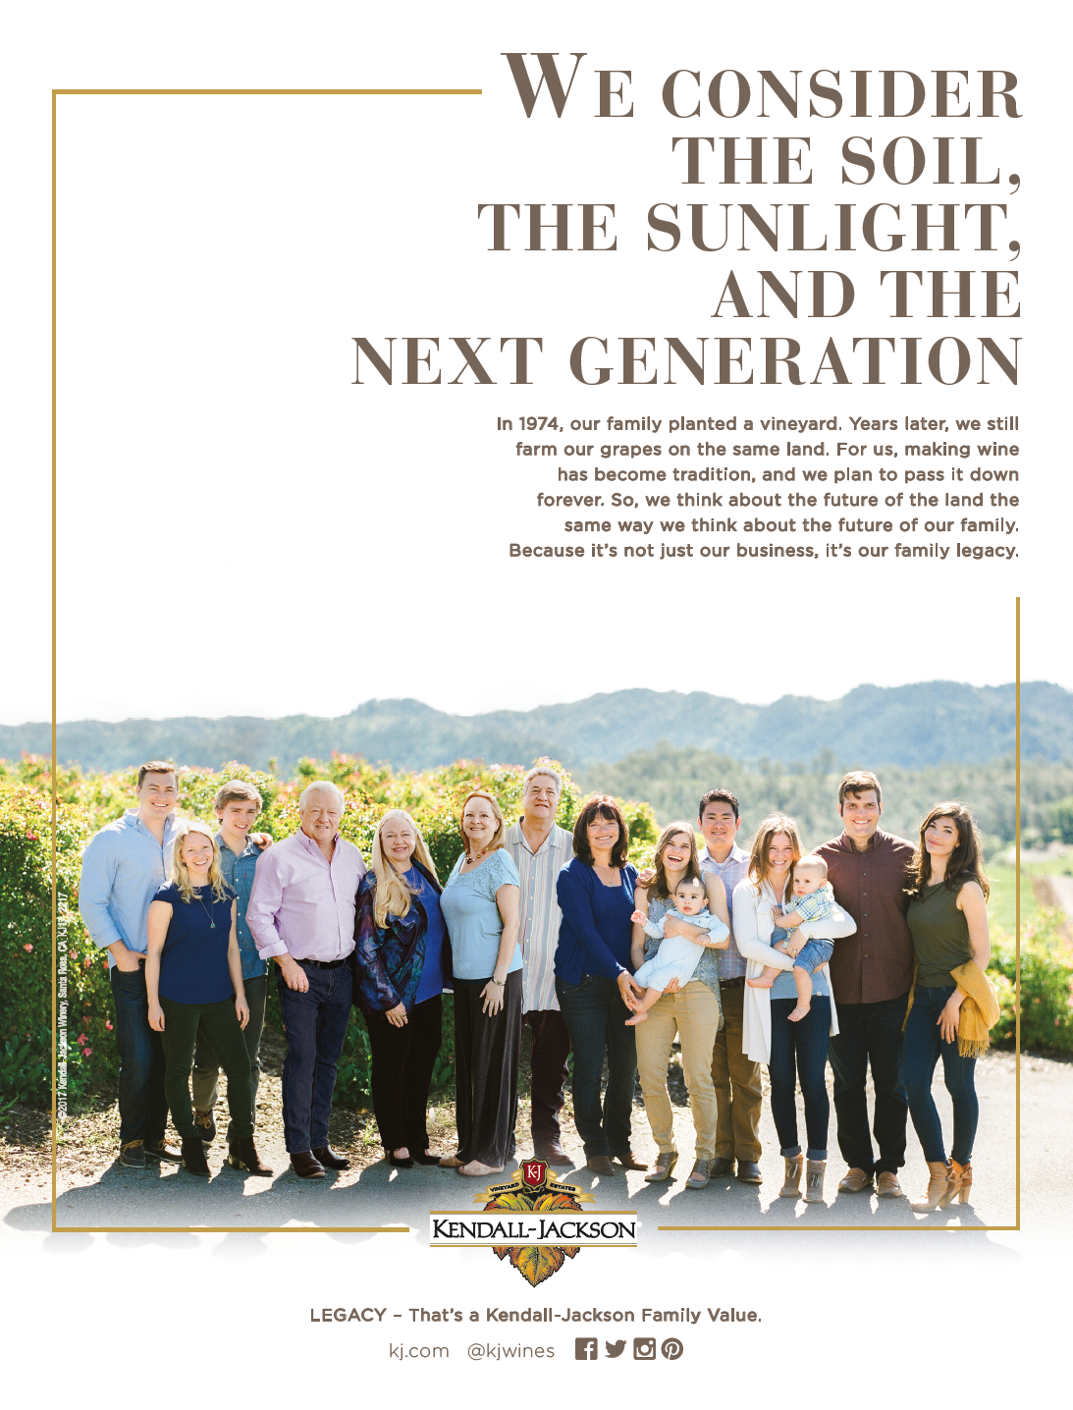
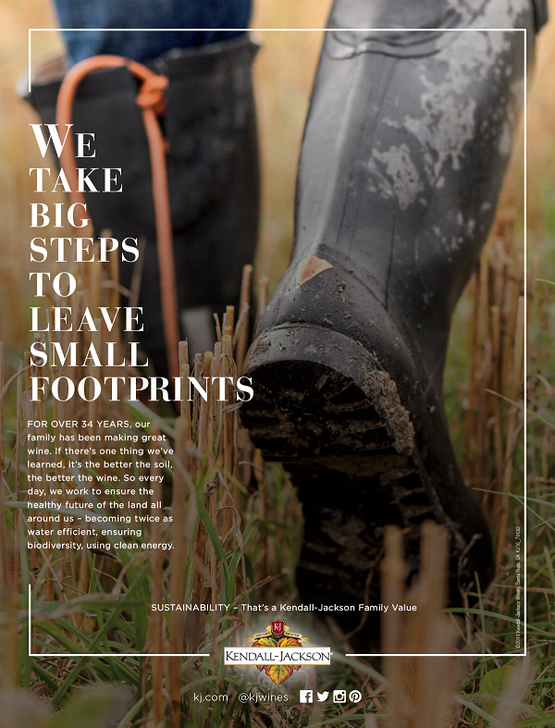
Notes:
The largest of which is called “Family Values,” which highlights the family element and K-J’s sustainability efforts. This lives as an in-store campaign and in print advertising.

Slide 29
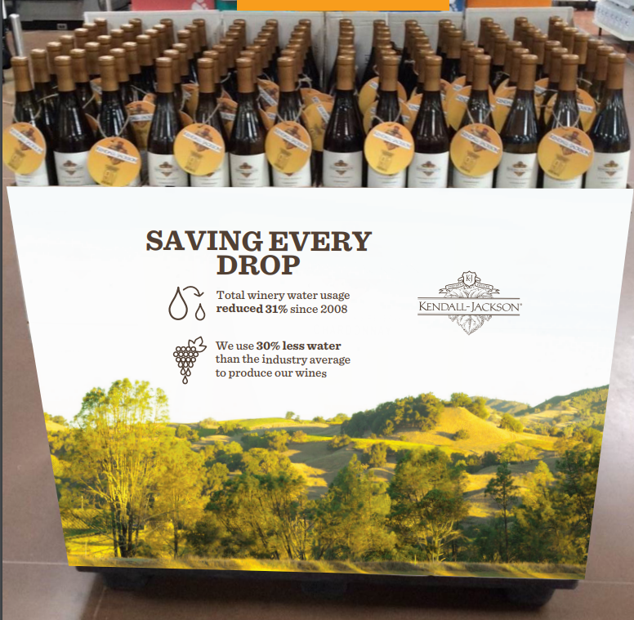
Notes:
Also produced “case wraps” that highlight our water savings – these wrap around a stack of cases in the store to create a more unified display.

Slide 30
Notes:
Finally, we did run a more obvious sustainability campaign for one of our Kendall-Jackson product tiers called Avant. We felt this wine was already appealing to a younger demographic, so we tried a “Wine Powered by Wind” campaign in-store with a real moving windmill. A poll of our sales force revealed that it was very-to-somewhat effective, but we can certainly do better.

Slide 32
Sustainability Impacts Wine Trade Purchasing
Demand for sustainable wine has increased over the past 5–10 years and is likely to continue to grow over the next decade
73% of Trade accounts either frequently or occasionally consider sustainable practices when selecting wines
Takeaway: Verification by an independent third party is an important aspect of sustainability
Pest management, water conservation and protecting natural resources are viewed as defining sustainability attributes
Sources: 2016 Full Glass Research, Wine Opinions
Notes:
Our partners in the wine trade are telling us that they want more sustainable wine…

Slide 33
Trade’s Top obstacles to selling sustainable wine?
Source: Wine Opinions National Trade Panel 2016
Notes:
…and yet they haven’t cracked the code on how to sell it!

Slide 34
And wine is a bit unusual among “green” products…
25% of frequent wine consumers consider wine to have a LOW environmental impact
Source: Full Glass Research 2015
Notes:
An additional hurdle is that consumers generally don’t think of wine as having much environmental impact to begin with.

Slide 35
For Top Wine Consumers, Sustainability is a Key Purchase Driver – tied with Region & Scores
Source: Ipsos Affluent Wine Consumer Report, N = 1,999 ages 25-69, $150K+ HHI and drink 2+ glasses of wine per week. Top Wine consumers = True Connoisseur segment, 13% of affluent consumers, 35% of wine sales. Q: How important are the following considerations when buying a bottle of wine?
Notes:
Julien
This study surveyed the top affluent wine consumer (identified as the true connoisseurs segment - people who purchase JFW products - $150K annual HHI and drink wine daily). While a small segment (13% of affluent consumers), they represent a third of wine sales. We see that sustainability is much more important for these consumers affluent wine drinkers about key purchase drivers.
Sustainability is tied with what everyone has considered the two of the top purchase drivers for so long (region, scores).

Slide 36
INTRODUCING K-J’S
BUSINESS CASE COMPETITION

Slide 37
Kendall-Jackson / Net Impact Sustainability Business Case Competition
Open Challenge Round: Today – early December 2017
What’s working & what’s not with current K-J sustainability messaging?
What do you recommend K-J do to connect our commitment to consumers at point of purchase?
Deliverable: 1-2 page narrative recommendation
Semi-Final Challenge Round: early January – late February 2018
Top 10-15 submissions selected
Leverage SWOT and other tools to analyze KJ’s current MarComm strategies
Deliverable: New marketing campaign for K-J (12 months / $1MM) that include peer group/in-store insights, a review of social media channels, and budgets/sales forecasts
Final Round Presentations: late March / early April 2018
Top 3 teams invited to Santa Rosa for final pitches to K-J Executive Judging Panel
GRAND PRIZE: K-J SELECTS 2 PAID SUMMER INTERNS

Slide 38
GROUP EXERCISE

Slide 39
Interactive Activity: You Be The Marketer
Of Kendall-Jackson’s sustainability achievements / goals, which is most compelling?
How would you bring it to life in a way that would appeal to young professionals? Sketch out your concept.
In-store Display
Print Ad
Billboard
Wildcard
Your table is your team
Teams with the top 4-5 concepts will present at the end

Slide 40
Thank you!

